Slide 1
Preparation of Self Assessment Report (SAR)
NBA Awareness Webinar on OBE and Accreditation, CoEP,Maharashtra
Dr. R. V. Ranganath
Professor, Department of Civil Engineering,
BMS College of Engineering, Bengaluru -19
rvranganath.civ@bmsce.ac.in
27th Nov, 2020.

Slide 2
SAR Context
Provides preparedness status at I/P level for the NBA visit,
Provides the first impression about the I/P to the evaluation team,
Presents crisp program status to the evaluation team and addresses process and the extent to which, a program meets each criterion,
Provides documented evidences, which the evaluation team maps/matches with the visual /oral evidences during the visit.

Slide 3
SAR Contents
PART A | Institutional Information
PART B | Criteria Summary
Criteria No. | Program Level Criteria
1 | Vision, Mission and Program Educational Objectives
2 | Program Curriculum and Teaching-Learning Processes
3 | Course Outcomes and Program Outcomes
4 | Students’ Performance
5 | Faculty Information and Contributions
6 | Facilities and Technical Support
7 | Continuous Improvement

Slide 4
Contd.
Criteria No. | Institute Level Criteria
8 | First Year Academics
9 | Student Support Systems
10 | Governance, Institutional Support and Financial Resources
PART C | Declaration by the Institution
Annexure-I | Program Outcomes (POs) & Program Specific Outcomes (PSOs)

Slide 5
Marks Comparison of SAR of UG Engineering Tier-I & Tier II
 | S.No. | Criteria | UG Engineering
 |  |  | Tier-I | Tier-II
 | 1. | Vision, Mission and Program Educational Objectives | 50 | 60
 | 2. | Program Curriculum and Teaching – Learning Processes | 100 | 120
 | 3. | Course Outcomes and Program Outcomes | 175 | 120
 | 4. | Students’ Performance | 100 | 150
 | 5. | Faculty Information and Contributions | 200 | 200
 | 6. | Facilities and Technical Support | 80 | 80
 | 7. | Continuous Improvement | 75 | 50
 | 8. | First Year Academics | 50 | 50
 | 9. | Student Support Systems | 50 | 50
 | 10. | Governance, Institutional Support and Financial Resources | 120 | 120
 | TOTAL |  | 1000 | 1000

Slide 6
CRITERION-1:
Vision, Mission and Program Educational Objectives (PEOs)
1.1. State the Vision and Mission of the Department and Institute.
Vision statement typically indicates aspirations and Mission statement states the broad approach to achieve aspirations
Should be written in a simple language, easy to communicate and should define objectives which are out of reach in the present context
Department Vision and Mission statements shall be consistent with the Institute Vision and Mission statements
1

Slide 7





Vision and Mission Statements
(as per NBA document)
Vision is a futuristic statement that the institution would like to achieve over a long period of time, and Mission is the means by which it proposes to move toward the stated Vision
Example..
Action verb ??
Vision:
To emerge as one of the nation’s finest Institutions in the field of Technical Education and Research through focused, effective and sustained monitoring of its programmes and resources.
Mission:
To develop high quality professionals ingrained in ethics, wisdom and creativity for the betterment of the society.

Slide 8
Evaluation
A. Availability of the Vision and Mission statements of the Department (1)
B.
C.
Appropriateness/Relevance of the Statements (2)
Consistency of the Department statements with the Institute statements (2)
(Here Institute Vision and Mission statements have been asked to ensure consistency with the department Vision and Mission statements; the assessment of the Institute Vision and Mission will be done in Criterion 10)
Exhibits/Context to be Observed/Assessed:
Vision & Mission Statements
Correctness from definition perspective
Consistency between Institute and Department statements

Slide 9
Program Educational Objective-PEO
The educational objectives of an engineering degree program are the statements that describe the expected achievements of graduates in their career, and also in particular, what the graduates are expected to perform and achieve during the first few years after graduation.
The PEOs, may be guided by global and local needs, vision of the Institution, long term goals etc.
For defining the PEOs the faculty members of the program must continuously work with all
Stakeholders: Local Employers, Industry, Students and the Alumni

Slide 10
1.2. State the Program Educational Objectives (PEOs).
Contd.
Define the PEOs under the following broad categories:
Preparation : Employment/Higher studies
Core competence : Discipline knowledge
Professionalism : Professional value - knowledge development
Life long learning : Environment
A. Listing of the Program Educational Objectives (3 to 5) of the program under consideration (5)
Exhibits/Context to be Observed/Assessed:
A. Availability & correctness of the PEOs statements

Slide 11
PEOs (Samples)
Graduates after 3-5 years, will be able to:
PEO1:
Compete on a global platform to pursue their professional career in Electrical Engineering and allied disciplines.
PEO2:
Pursue higher education and/or engage in continuous up gradation of their professional skills.
PEO3:
Communicate effectively while working in diverse team.
PEO4:
Demonstrate concern for society and environment.

Slide 12
1.3. Indicate where the Vision, Mission and PEOs are published and disseminated among stakeholders (PEOs). (15)
Contd.
Availability on Institute website under relevant program link
Availability at department notice boards
HoD Chamber
Department website, if available
Availability in department level documents
Documentary evidence
Adequacy in respect of publication & dissemination (3)
Process of dissemination among stakeholders (3)
Extent of awareness of Vision, Mission and PEOs among the stakeholder (9)

Slide 13
Exhibits/Context to be Observed/Assessed:
Contd.
Adequacy
Department Vision, Mission and PEOs: Availability on Institute website under relevant program link; Availability at department notice boards, HoD Chamber, department website, if Available; Availability in department level documents/course of study
Process of dissemination
Documentary evidence to indicate the process which ensures awareness among internal and
external stakeholders with effective process implementation
Extent of Awareness
Based on interaction with internal and external stakeholders

Slide 14
1.4. State the process for defining the Vision Department and PEOs of the program.(15)
Contd.
and Mission of the
Process to ensure:
Effective participation of Stakeholders
Effective Process implementation
Documentary evidence
Description of process involved in defining the Vision, Mission of the Department (07)
Description of process involved in defining the PEOs of the program (08)
Exhibits/Context to be Observed/Assessed:
Documentary evidence to indicate the process which ensures effective participation of internal and
external department stakeholders with effective process implementation

Slide 15
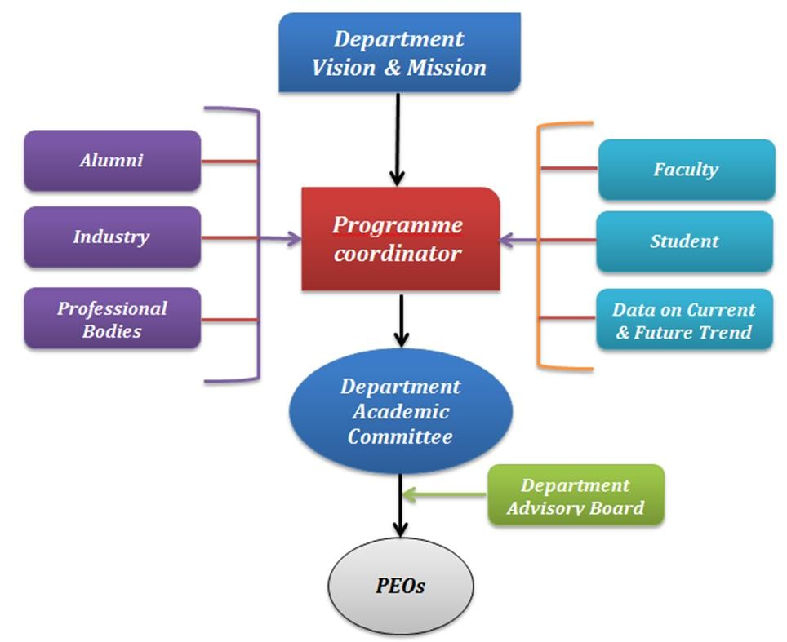
Processes for PEOs
Feedback collecting stakeholders
format for data from
A process by which PEOs are created and reviewed periodically
A process to evaluate to what extent PEOs are attained
Review, Mid correction, and Continuous Quality Improvement

Slide 16
1.5. Establish consistency of PEOs with Mission of the Department (10)
Contd.
Generate a “Mission of the Department – PEOs matrix” with justification and rationale of the mapping:
PEO Statements | M1 | M2 | …… | Mn
PEO 1
PEO 2
PEO 3
PEO 4
Note:
M1, M2, . . Mn are distinct elements of Mission statement. Enter correlation levels 1, 2 or 3 as defined below:
1: Slight (Low)
2: Moderate (Medium)
3: Substantial (High)
If there is no correlation, put “-”

Slide 17
Mission of the Department:
PEO1: Graduates will have successful career in the field of Civil Engineering
PEO2: Graduates will respond to growing demands of society through professional and ethical practices
PEO3: Graduates will pursue lifelong learning including higher studies in the field of Civil Engineering
M1: Make competent Civil Engineers with high level of professional, moral and ethical values
M2:Impart highest standards in theoretical as well
as practical knowledge and skill set
M3:Establish Center of Excellence in major areas of Civil Engineering to respond to the current and future needs of the industry
What is Expected here ?
Establish consistency of PEOs with Mission of the Department (10)
Generate a “Mission of the Department – PEOs matrix” with justification and rationale of the mapping
PEO Statements | M1 | M2 | M3 | …Mn
PEO 1 | 3/2/1 ? | 3/2/1 ? | ?
PEO 2
PEO 3 | 3/2/1 ?
PEO 4

Slide 18
A. Preparation of a matrix of PEOs and elements of Mission statement (05)
Consistency/justification of co-relation parameters of the above matrix (05)
Exhibits/Context to be Observed/Assessed:
  Availability of a matrix having PEOs and Mission elements
  Justification for each of the elements mapped in the matrix

Slide 19
2.1. Program Curriculum (20)
CRITERION-2: Program Curriculum and Teaching – Learning Processes (TLP)
    State the process used to identify extent of compliance of the University curriculum for attaining the Program Outcomes and Program Specific Outcomes as mentioned in Annexure-I. Also mention the identified curricular gaps, if any (10)
      State the process details
      Mention identified curricular gaps
      Extent of compliance
Exhibits/Context to be Observed/Assessed:
Documentary evidence to indicate the process which ensures mapping/compliance of
University Curriculum with the POs & PSOs; Identification of gaps; if any.
Identified Curricular gaps and its Appropriateness

Slide 20
2.1.2. State the delivery details of the content beyond the syllabus for the attainment of POs & PSOs (10)
Contd.
Details of the following for the attainment of POs & PSOs
Additional course
Learning material/Content
Laboratory experiments
Projects etc.
Institute to provide inputs to the Affiliating University regarding curricular gaps and possible addition of new content/add-on courses in the curriculum to better attain program outcome(s)

Slide 21
Curriculum- Tier 2
Analyze the University Curriculum
  Determine the Gaps in Attainment of POs
  Design Extra {modules} I {Assessments} to Bridge these gaps
  Could need a few iterations

Slide 22
Analysis may indicate that not all POs are Attainable with the Given Curriculum.
May need some additional modules and Design of In-Sem evaluation and assessment to take care of the gaps.
A record of all this work is needed.

Slide 23
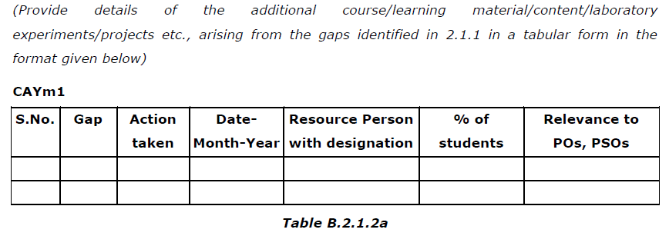
Steps taken to get identified gaps included in the curriculum. (e.g. letter to university/BOS) (2)
Delivery details of content beyond syllabus (5)
Mapping of content beyond syllabus with the POs & PSOs (3)
Exhibits/Context to be Observed/Assessed:
Documentary evidence of steps taken at regular interval
Delivered details – documentary evidence for at least one sample per assessment year to be verified
C.
Availability and appropriateness of Mapping table between contents delivered and Program
outcomes/Program specific outcomes (Course outcomes)

Slide 24
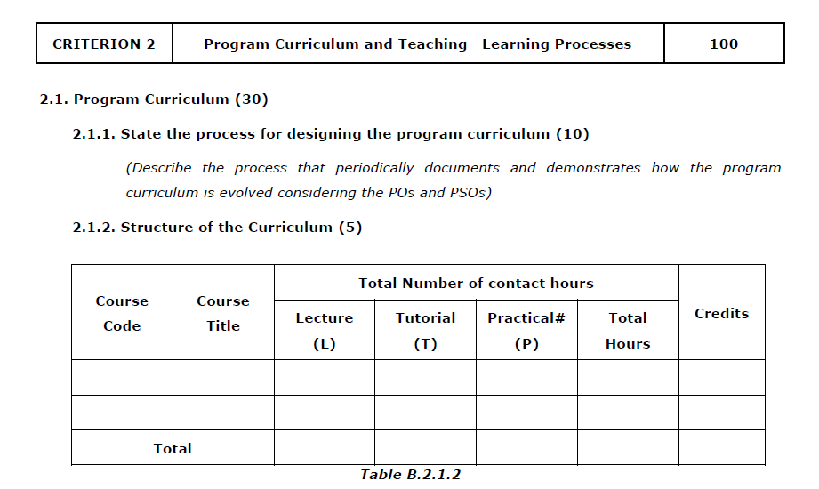
Tier 1:

Slide 25
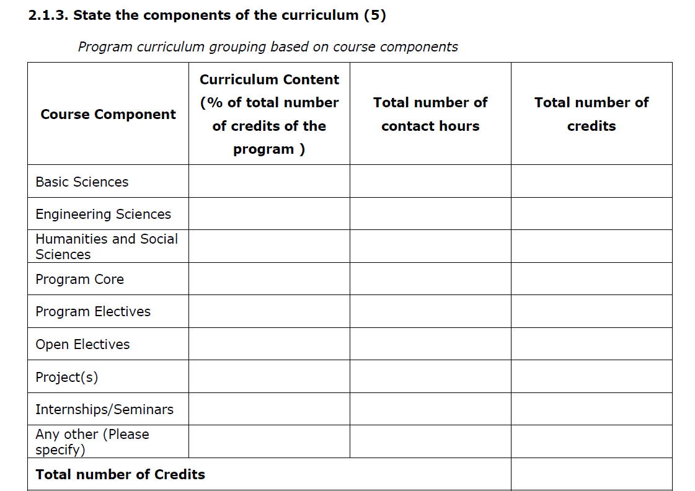
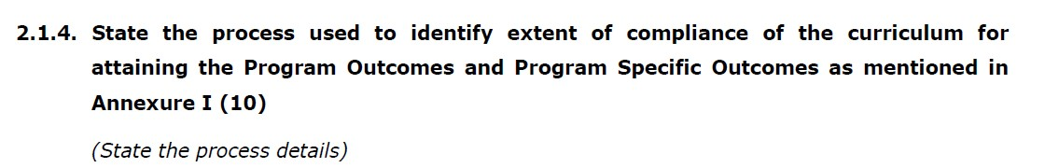

Slide 26
2.2. Teaching-Learning Processes.(70)
Contd.
    Describe Processes followed to improve quality of Teaching and Learning (15) Processes may include adherence to academic calendar and implementation of pedagogical initiatives such as -
      Real life examples
      Collaborative learning
Quality of laboratory experience experiments
Recording observations
Analysis of data etc.
Encouraging bright students
Assisting weak students etc.
ICT supported learning
Interactive classrooms
with regard to conducting

Slide 27
Adherence to Academic Calendar (2)
Use of various instructional methods and pedagogical initiatives (2)
Methodologies to support weak students and encourage bright students(2)
Quality of classroom teaching (Observation in a Class) (2)
Conduct of experiments (Observation in Lab) (2)
Continuous Assessment in the laboratory (3)
Student feedback of teaching learning process and actions taken (2)
Exhibits/Context to be Observed/Assessed:
  Availability of Academic Calendar based on University academic calendar and its effective compliance
  Documentary evidence to support implementation of pedagogical initiatives such as real life examples, collaborative
learning, ICT supported learning, interactive class rooms etc.
  Guidelines to identify weak and bright students; post identification actions taken; impact observed
  Class room ambience; efforts to keep students engaged (also to be verified during interaction with the students)
  Quality of laboratory experience with respect to conducting, recording observations, analysis etc.(also to be verified during interaction with the students)
  Internal Semester examination and internal marks thereof, Practical record books, each experiment assessment, final marks based on assessment of all the experiments and other assessments; if any
  Feedback format, frequency, analysis and actions taken (also to be verified during interaction with students)

Slide 28
2.2.2. Quality of internal semester Question papers, Assignments and Evaluation.
Contd.
Mention the initiatives, Implementation details and analysis of learning levels related to –
Quality of Semester Question papers
Assignments
Evaluation
Relevance to COs
Exhibits/Context to be Observed/Assessed:
Process of internal semester question paper setting, model answers, evaluation and its compliance
Question paper validation to ensure desired standard from outcome attainment perspective as well as learning levels perspective
Mapping of questions with the Course outcomes
Assignments to promote self-learning, survey of contents from multiple sources, assignment evaluation and feedback to the students, mapping with the COs

Slide 29
2.2.3. Quality of Student Projects
Contd.
Consideration to factors including, but not limited to –
Environment & Safety
Ethics
Cost
Type (application, product, research, review etc.)
Standards
Processes related to project identification, allotment, continuous monitoring and evaluation
Demonstration of working prototype sand enhancing the relevance of projects.
Mention Implementation details including details of POs and PSOs addressed with justification
Exhibits/Context to be Observed/Assessed:
Projects identification and guide allocation Process
Projects classification (application, product, research, review etc.) consideration to factors such as environment, safety, ethics, cost, standards and mapping with program outcomes and program specific outcomes
Continuous monitoring mechanism and evaluation
Methodology (Appropriately documented) to assess individual contribution/ understanding of the project as well as collective contribution/understanding
Based on Projects demonstration
Quality of place (host) where the paper has been published /quality of competition in which award has been won

Slide 30
2.2.4. Initiatives related to industry interaction
Contd.
Industry supported laboratories.
Industry involvement in the program design and partial delivery of any regular courses for students.
Impact analysis of industry institute interaction and actions taken thereof
Exhibits/Context to be Observed/Assessed:
Type of Industries, Type of Labs, objectives, utilization and effectiveness
Documentary evidence
Analysis and actions taken thereof
2.2.5. Initiatives related to industry internship/summer training
Industrial training/tours for students.
Industrial / internship / summer training of more than two weeks and post training Assessment.
Impact analysis of industrial training.
Student feedback on initiatives

Slide 31
Exhibits/Context to be Observed/Assessed:
A. & B. Type of Industries, planned or non-planned activity, objectives clearly defined, no. of students participated, relevant area of training, visit report documented
C.& D. Impact analysis and feedback format, analysis and actions taken (also to be verified during interaction with students)

Slide 32
CRITERION 3: Course Outcomes and Program Outcomes
  Establish the correlation between the Courses and the Program Outcomes (POs) and Program Specific Outcomes (PSOs)
    Course Outcomes (COs)
SAR should include course outcomes of One course/Semester (3rd to 8th) of study, however, should be prepared for all courses and made available as evidence
Exhibits/Context to be Observed/Assessed:
A. Appropriateness of the statements shall be seen for at least one course each from 2nd, 3rd
and final year of study

Slide 33
CRITERION 3: Course Outcomes and Program Outcomes
    CO-PO matrices of courses selected in 3.1.1 (six matrices to be mentioned; one per semester from 3rd to 8th semester)
      Explanation of table to be ascertained (5)
Exhibits/Context to be Observed/Assessed:
A. Mapping to be verified for atleast two matrices

Slide 34
Note: Enter correlation levels 1, 2 or 3 as defined below:
Contd.
1: Slight (Low)
2: Moderate (Medium)
3: Substantial (High)
3.1.3. Program level Course-PO matrix of all courses INCLUDING first year courses
It may be noted that contents of Table 3.1.2 must be consistent with information available in Table 3.1.3 for all the courses.
Exhibits/Context to be Observed/Assessed:
A. Mapping to be verified for atleast one course per year of study; program outcomes and program specific outcomes getting mapped with the core courses are also to be verified

Slide 35
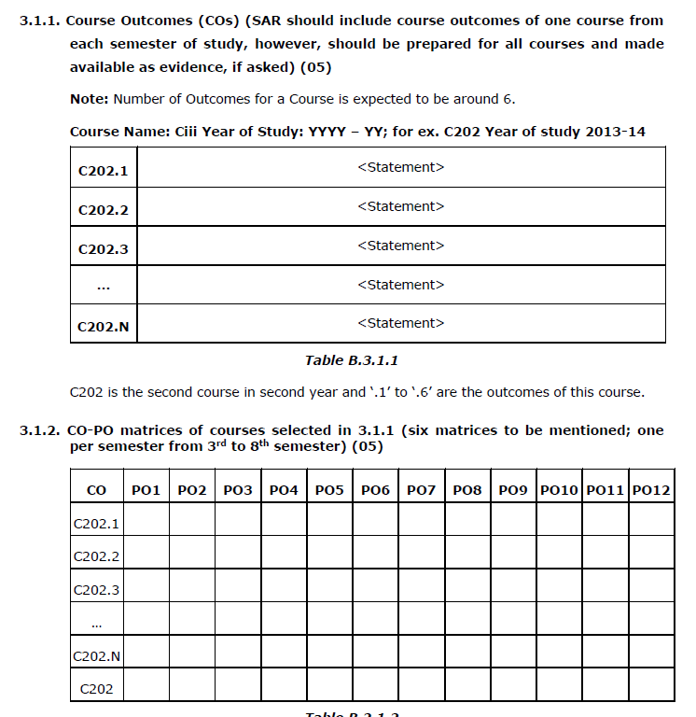

Slide 36
Program Outcomes
POs are statements about the knowledge, skills and attitudes (attributes) the graduate of a formal engineering program should have.
Profile of the Graduates reached through POs - Target
POs are defined by Accreditation Agencies of the country (NBA in India)

Slide 37
Program Outcomes (POs)
Engineering Knowledge: Apply the knowledge of mathematics, science, engineering fundamentals, and an engineering specialization to the solution of complex engineering problems.
Problem Analysis: Identify, formulate, review research literature, and analyze complex engineering problems reaching substantiated conclusions using first principles of mathematics, natural sciences, and engineering sciences.
Design/Development of Solutions: Design solutions for complex engineering problems and design system components or processes that meet the specified needs with appropriate consideration for the public health and safety, and the cultural, societal, and environmental considerations
Conduct Investigations of Complex Problems: Use research-based knowledge and research methods including design of experiments, analysis and interpretation of data, and synthesis of the information to provide valid conclusions.

Slide 38
5. Modern Tool Usage: Create, select, and apply appropriate
Conti…
techniques, resources, and modern engineering and IT tools including prediction and modeling to complex engineering activities with an understanding of the limitations.
The Engineer and Society: Apply reasoning informed by the contextual knowledge to assess societal, health, safety, legal and cultural issues and the consequent responsibilities relevant to the professional engineering practice.
Environment and Sustainability: Understand the impact of the professional engineering solutions in societal and environmental contexts, and demonstrate the knowledge of, and need for sustainable development.
Ethics: Apply ethical principles and commit to professional ethics and responsibilities and norms of the engineering practice.

Slide 39
9. Individual and Team Work: Function effectively as an individual, and as a member or leader in diverse teams, and in multidisciplinary settings.
Conti…
Communication: Communicate effectively on complex engineering activities with the engineering community and with society at large, such as, being able to comprehend and write effective reports and design documentation, make effective presentations, and give and receive clear instructions.
Project Management and Finance: Demonstrate knowledge and understanding of the engineering and management principles and apply these to one’s own work, as a member and leader in a team, to manage projects and in multidisciplinary environments.
Life-long Learning: Recognize the need for, and have the preparation and ability to engage in independent and lifelong learning in the broadest context of technological change.

Slide 40


PROGRAM SPECIFIC OUTCOMES (PSO)
These outcomes are specific to a program in addition to NBA defined POs, namely, Civil, Mechanical, Chemical, Computer science etc.,(2-4)
ELECTRICAL & ELECTRONICS ENGINEERING
At the end of the program, students will have the ability to:
PSO1
Develop models, analyze and assess the performance of different types of generation, transmission, distribution and protection mechanisms in power systems.
PSO2
Design, develop, analyze and test electrical and electronics systems; deploy control strategies for power electronics related and other applications.
PSO3
Measure, analyze, model and control the behavior of electrical quantities associated with constituents of energy or allied systems.

Slide 41
Why the NBA's POs are What they are?
Source: NBA learning resources

Slide 42
WA - Graduate Attr NBA- Program Outc | ibutes and omes
Washington Accord Attributes | NBA Program Outcomes.
!.Engineering knowledge, Apply knowledge of mathematics, science, engineering fundamentals and an engineering specialization to the solution of complex engineering problems. | !.Engineering knowledge, Apply the knowledge of mathematics, science, engineering fundamentals, and engg. specialization to the solution of complex engineering problems
2. Problem Analysis, Identify, formulate, research literature and analyze complex engineering problems reaching substantiated conclusions using first principles of mathematics, natural sciences and engineering sciences | 2. Problem Analysis, Identify, formulate, research literature, and analyze engineering problems to arrive at substantiated conclusions using first principles of mathematics, natural, and engineering sciences.
Source: NBA learning resources

Slide 43
Attainment of PO1 to P05

Slide 44




PO 1-5
POl. Engineering knowledge: Apply the knowledge of mathematics, science, engineering fundamentals, and engineering. specialization to the solution of complex engineering problems.
PO2. Problem analysis: Identify, formulate, review research literature, and analyze complex engineering problems reaching substantiated conclusions using first principles of mathematics, natural sciences, and engineering sciences.
PO 3 Design/development of solutions: Design solutions for complex engineering problems and design system components, processes to meet the specifications with consideration for the public health and safety, and the cultural, societal, and environmental considerations.
Conduct Investigations of Complex Problems: Use research-based knowledge and research methods including design of experiments, analysis and interpretation of data, and synthesis of the information to provide valid conclusions.
Modern Tool Usage: Create, select, and apply appropriate techniques, resources, and modern engineering and IT tools including prediction and modeling to complex engineering activities with an understanding of the limitations.

Slide 45





Complex Engineering Problem-CEP


Problems not the kind generally encountered at the ends of text book chapters. (These often test if the contents of the chapter have been understood)
These are problems that have not been
completely framed and leave at least a few* choices for the student to make.
Problems may require use of laws of physics, or bring in some mathematical tools in which the problem can be framed.

Slide 46
Course Outcomes (COs)
“Statements of observable student actions that serve as evidence of the Knowledge, Skills and Attitudes acquired in a course”.
Each course is designed to meet (about 6) Course Outcomes
The Course Outcomes are stated in such a way that they can be actually measured.
POs are attained through program specific Core Courses

Slide 47
Course Outcomes
Engineering Physics (Not a Good Example)
CO1: Understand the knowledge of basic quantum mechanics, to set up one-dimensional Schrodinger’s wave equations and its application to few physical problems.
CO2: Understand the fundamental aspects of crystallography, able to recognize various planes in a crystal and have knowledge of structure determination using x-rays.
CO3: Understand the role of free electrons in determining the properties of metals, the concept of Fermi energy, and the domain formation in ferromagnetic materials.
CO4: Understand the basic laser physics, working of lasers, holography and principle of propagation of light in optical fibers.
CO5: Understand the theory of free, damped and forced vibrations of a particle and also the concept of resonance and its applications in ESR & NMR.
What level of BLOOM,s Taxonomy you want your students to achieve?

Slide 48
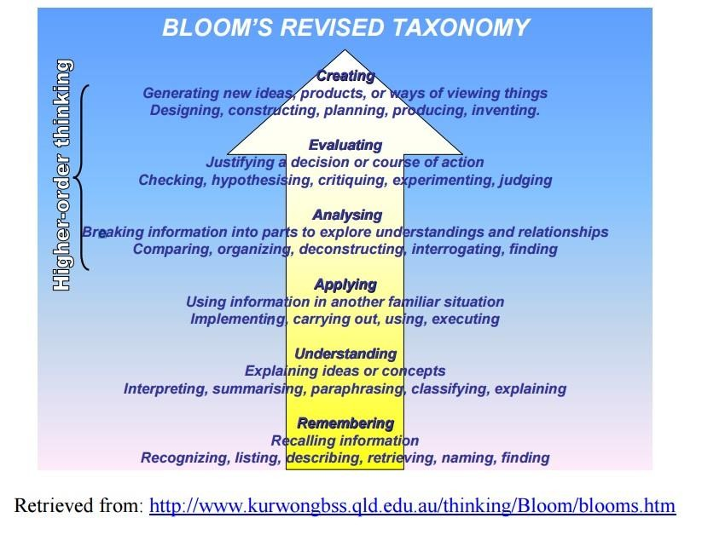

Slide 49
Comparison
Bloom’s Levels | Program Outcomes
Remember (K1)
Understand (K2)
Apply (K3) | Apply Knowledge | Engineering Knowledge: Apply the knowledge of mathematics, science, engineering fundamentals, and an engineering specialization to the solution of complex engineering problems
Analyze (K4) | Problem Analysis | Problem Analysis: Identify, formulate, review research literature, and analyze complex engineering problems reaching substantiated conclusions using first principles of mathematics, natural sciences, and engineering sciences
Evaluate (K5) | Design/Develop ment of Solutions | Design/Development of Solutions: Design solutions for complex engineering problems and design system components or processes that meet the specified needs with appropriate consideration for the public health and safety, and the cultural, societal, and environmental considerations.

Slide 50



Structure of Course Outcomes:
Course Outcome statement may be broken down into two main components:
An action word that identifies the performance to be demonstrated;
Learning statement that specifies what learning will be demonstrated in the performance;
Examples of good action words to include in course outcome statements:
Compile, identify, create, plan, revise, analyze, design, select, utilize, apply, demonstrate, prepare, use, compute, discuss, predict, assess, compare, rate, critique, outline, or evaluate

Slide 51
Course Title: Strength of Materials
Course Outcomes: Example
At the end of the course, student is able to:
Action Verb
1. Apply laws of physics (eg..Hook’s law, etc.,) to compute different types of response (stress and deformation) in the
given materials. (PO 1)
Learning Statement
Analyse structural elements for different force systems to compute design parameters (BM and SF) (PO2)
Design compression elements using engineering principles to resist any given loads. (PO3)
Conduct experiments to validate physical behaviour of materials/components.(PO4)
Prepare laboratory reports on interpretation of experimental results (P10)

Slide 52
CO-PO Relationship
Each CO can be identified to address a subset of POs
Based on the number of COs and the sessions dedicated to them it is possible to identify the strength of mapping (1, 2 or 3) to POs
Based on these strengths of selected POs a CO matrix can be established.

Slide 53




PO1:
Engineering Knowledge: Apply the knowledge of mathematics,
science, engineering fundamentals, and an engineering specialization to the solution of complex engineering problems
Example Situation 1:
CO3:
Able to understand mix proportioning techniques for
field applications.
Assessment for CO3: (Question in Tests)
Briefly explain the proportioning techniques.
various methods of mix
Does this CO reflects the intended measurement from PO1?
Does the assessment correlates well with the CO?
Mapping: CO3- PO1.

Slide 54



PO3:
Design/Development of Solutions: Design solutions for complex
engineering problems and design system components or processes that meet the specified needs with appropriate consideration for the public health and safety, and the cultural, societal, and environmental considerations.
Example Situation 3: CO3: Able to Design concrete mix for field applications using characteristics of mix constituents and relevant IS codes.
Assessment:/ASIGNMENT/ ABC Construction Company is entrusted with manufacturing of precast elements for elevated express way. The precast elements are required to attain 40 MPa in 7 days. Design a mix for least cost. The mix should comply with the requirements of IS 10262 and IS 456.
Is CO reflects the intended measurement from PO2, PO3 ? Does the assessment correlates well with the CO? | Remarks: CO2 – PO2, PO3

Slide 55
Course Title: Concrete Technology
Course Outcomes | PO 1 | PO 2 | PO 3 | PO 4 | PO 5 | PO 6 | PO 7 | PO 8 | PO 9 | PO 10 | PO 11 | PO 12
Uunderstand mix proportioning techniques for field applications.
Apply mix proportion principles to proportion a concrete mix for field applications. | 3
Design concrete mix for field applications using characteristics of mix constituents and relevant IS codes. |  |  | 3
Prepare a comprehensive report on new knowledge in any one of the topic related to concrete technology |  |  |  |  |  |  |  |  | 2 | 3 |  | 3

Slide 56
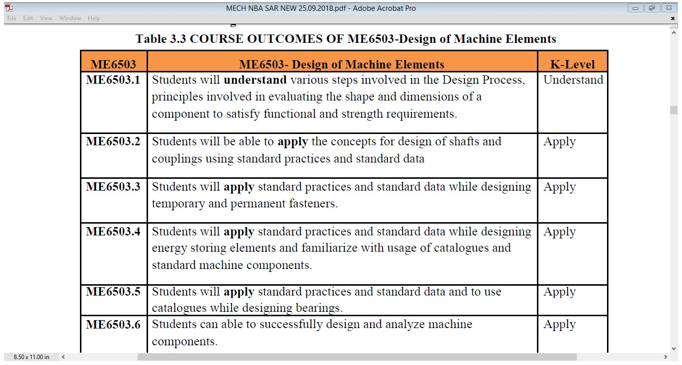
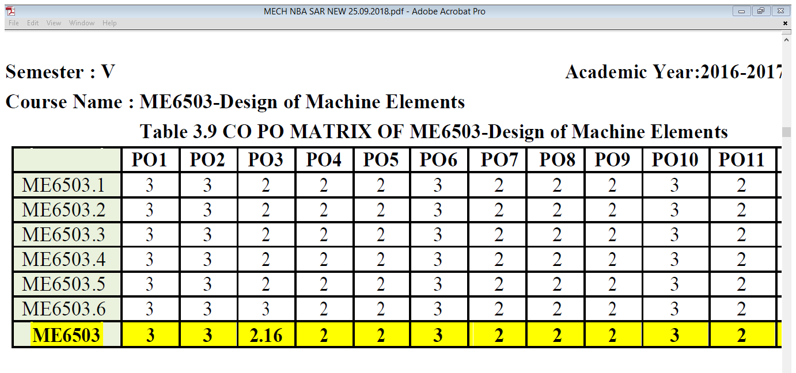
Communication

Slide 57
What are the ways for teachers to target complex engineering problems ?
Can PBL help ?

Slide 58



Problem-Based Learning

Slide 59
Where
does PBL fit?
Inquiry Learning
Cooperative/ Collaborative Learning
Project-Based Learning
Problem-Based Learning
Case Studies

Slide 60

What’s the
Difference?
Project-Based Learning
Individual or group
Teacher defines the problem
Teacher identifies action steps
Create a product
Both
Teacher as guide
Students at centre
Real-world connections
Active learning
Self and peer assessment
Problem-Based Learning
Groups
Students define the problem
Students identify action steps
Create a solution
Metacognition
Bottom Line:
In Problem-Based Learning, students have more control over their own learning and the processes involved.

Slide 61
Advantages of Problem Based Learning
Can be incorporated in any course
Learner-centred
Students acquire content knowledge, skills and attitudes
Facilitates measurement of skill based Programme Out comes namely, Team work, Communication, Life long learning…

Slide 62
Problem
Sample

Slide 63
Problem Definition
BMS Construction Company has been in the forefront of
concrete construction in India. It
specializes in construction of Infrastructure and Buildings. The
company wants to hire construction engineers who can take proactive role in the future projects of the company and build their career along with the company. Following are the requirements of the concrete engineer who will be responsible for the sourcing of materials, quality control of materials, proportioning of concrete mixes using loca l l y a v a i l a b l e m a t e r i a l s fo r d if f e rent applications, evaluation of its properties (fresh, hardened and durability) pertaining to appropriate codes.

Slide 64
Expected Out Comes
The candidate should be well versed with the current trends of materials innovation, quality assurance practices, concrete production and testing methods and standards. Further, candidate is required to apply/demonstrate skills for communication, social concern and capacity to learn independently and reflect and implement new concreting requirement for the projects.

Slide 65
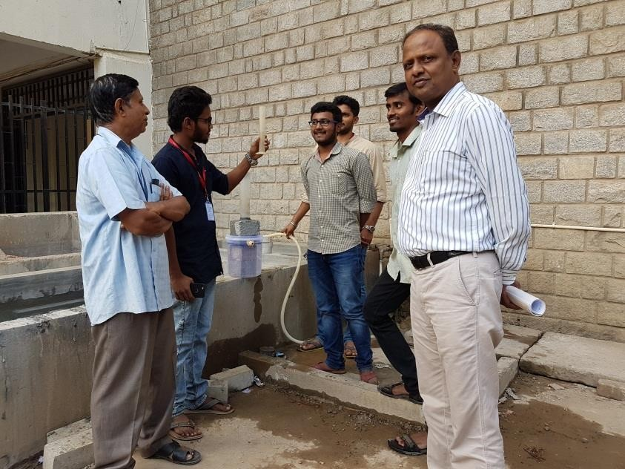

PBL - Example
Problem:
Development of Pervious concrete for pavements

Slide 66
Assessment strategy
Rubric for Evaluating Self Study
Course: 16CVCT1CCM- Advances in Construction Materials Problem – Develop a concrete mix for field applications Batch No: Title :
Performance Indicators ↓ | Unsatisfactory (2) | Developing (6) | Satisfactory (8) | Exemplary (10) | Score
Identifying Problem & Materials characteristics for possible solutions (PO1)
Choice of complexities of field requirement and identification of material characteristics (CO1-PO1) |  |  |  | Identified problem is complex and relevant to field application. All the characterization of material is carried out.
Research Analysis & Mix proportioning (PO2)
Identifying research gaps, setting objectives and Proportioning of mixes using standard methods (CO2-PO2)
Design of experiments (PO4)
Choice of Experiments to arrive at solutions. (CO3- PO4)
Communication and Life long learning (PO10, PO12)
Presentation and Reporting of work (CO4-PO10, PO12)
Total Score(Maximum, 40)

Slide 67







































CO-PO Attainment (Programme Level)
PO (1_12)
Identify Courses for PO attainment
Select 2 to 3 Compulsory Courses/Projects for each PO
Define appropriate COs and Devise Learning activities
COs mapped for POs, Strength of Correlation
Exam question papers
Assignment
Evaluate.
Projects (Rubrics)
Direct Tools
Assessment Methods
Indirect
Tools
Surveys (Course End & Exit Survey
Evaluation of COs and Judgement
Set Target
70% of
Students should score > 60%
PO Attainment

Slide 68
CO-PO Relationship
COURSE |  | COs | PO1 | PO2 | PO3 | PO4 | PO5 | PO6 | PO7 | PO8 | PO9 | PO10 | PO11 | PO12
Analysis of structures II |  | CO1 | 3 | 3 | - | - | - | - | - | - | - | - | - | -
 |  | CO2 | 3 | 3 | - | - | - | - | - | - | - | - | - | -
Envir | onmental Engineering I | CO1 | 3 | 2 | - | 3 | - | 3 | 3 | - | - | - | - | -
 |  | CO2 | 3 | 3 | - | - | - | 3 | 3 | - | - | 3 | - | -
 |  | CO3 | - | - | 3 | - | - | - | 3 | 3 | - | 3 | - | -
Geotechnical Engineering II |  | CO1 | 3 | 3 | - | - | - | - | - | - | - | - | - | -
 |  | CO2 | 3 | 3 | - | - | - | - | - | - | - | - | - | -
 |  | CO3 | 3 | 3 | - | - | - | - | - | - | - | - | - | -
 |  | CO4 | 3 | 3 | 2 | - | - | 3 | - | - | - | - | - | -
Concr | ete Technology | CO1 | 3 | - | - | - | - | - | - | - | - | - | - | -
 |  | CO2 | - | 3 | 3 | - | - | - | - | - | - | - | - | -
 |  | CO3 | - | 3 | 3 | - | - | - | - | - | - | - | - | -
 |  | CO4 | - | - | - | - | - | - | - | 3 | 3 | - | - | -
Hydrology and water resources |  | CO1 | 3 | 3 | - | - | - | - | - | - | - | - | - | -
 |  | CO2 | 3 | 3 | - | - | - | - | - | - | - | - | - | -
 |  | CO3 | 3 | 3 | 3 | - | - | - | - | 3 | - | - | - | -
Quan Costin | tity Surveying and g | CO1 | 3 | 3 | - | 1 | - | - | - | - | - | - | - | -
 |  | CO2 | 3 | 3 | - | - | 2 | 2 | - | - | - | - | - | -
 |  | CO3 | 3 | 3 | - | - | - | - | - | - | - | - | - | -
 |  | CO4 | 2 | 3 | 2 | - | - | 3 | - | - | - | - | - | -
Altern Techn | ate Building Material & ology | CO1 | 3 | - | - | - | - | - | 3 |  | - | - | - | 1
 |  | CO2 |  | 3 | - |  | - | - | 3 |  | - | - | - | 3
 |  | CO3 |  | - | - | - |  | - | 3 |  | - | - | - | 2
 |  | CO4 |  |  | 3 | - | 2 | - | 2 | 3 | - | - | - | -
Major | Project Phase II | CO1 | - | - | - | - | - | - | 3 | - | 3 | - | - | -
 |  | CO2 | 3 | 3 | 3 | 3 | - | - | - | 3 | 3 | - | - | 3
 |  | CO3 | - | - | - | - | 3 | - | - | - | 3 | - | - | -
 |  | CO4 | - | - | - | - | - | - | - | - | 3 | 3 | 2 | -

Slide 69
3.2. Attainment of Course Outcomes
Contd.
3.2.1. Describe the assessment processes used to gather the data upon which the
evaluation of Course Outcome is based
Examples of data collection processes may include, but are not limited to-
  Specific exam/tutorial questions
  Assignments
  Laboratory tests
  Project evaluation
  Student portfolios
A portfolio is a collection of artifacts that demonstrate skills, personal characteristics, and accomplishments created by the student during study period, internally developed assessment exams, project presentations, oral exams etc.
Exhibits/Context to be Observed/Assessed:
A. & B. Evidence for appropriate assessment processes including data collection, verification, analysis, decision making

Slide 70
3.2.2. Record the attainment of Course Outcomes of all courses with respect to set attainment levels
Contd.
Program shall have set Course Outcome attainment levels for all courses
The attainment levels shall be set considering average performance levels in the University Examination or any higher value set as target for the assessment years
Attainment level
  Student performance in internal assessments with respect the Course
Outcomes
  Performance in the University Examination
Exhibits/Context to be Observed/Assessed:
A. Methodology to define set levels and its compliance; data collection, verification, analysis and decision making; details for one course per year of study to be verified

Slide 71
Examples related to attainment levels Vs. targets:
Contd.
Attainment Level 1: 60% students scoring more than 60% marks out of the relevant maximum marks
Attainment Level 2: 70% students scoring more than 60% marks out of the relevant maximum marks
Attainment Level 3: 80% students scoring more than 60% marks out of the relevant maximum marks
Attainment is measured in terms of actual percentage of students getting set percentage of marks
If targets are achieved then the PY1ICPHY and CV3DCMOF are attained for that year. Program is expected to set higher targets for the following years as a part of continuous improvement
If targets are not achieved the program should put in place an action plan to attain the target in subsequent years
Similar targets and achievement are to be stated for the other midterm tests/internal assessment instruments

Slide 72



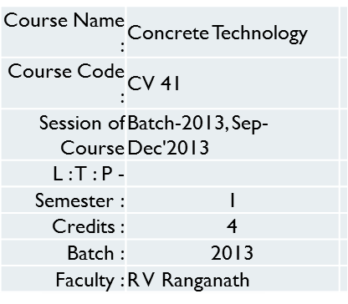
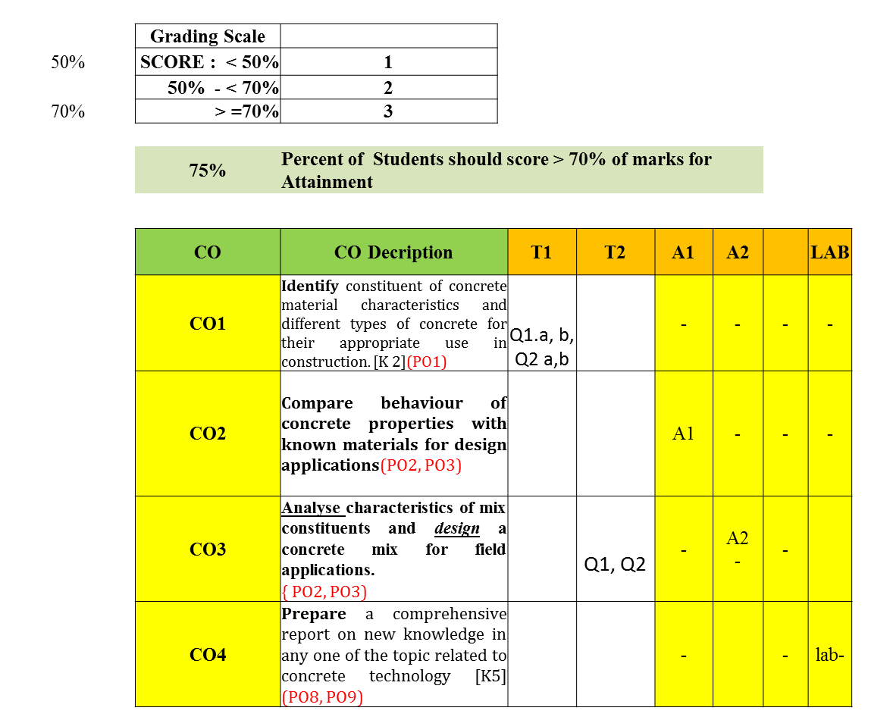
Example of CO-attainment for a course

Slide 73
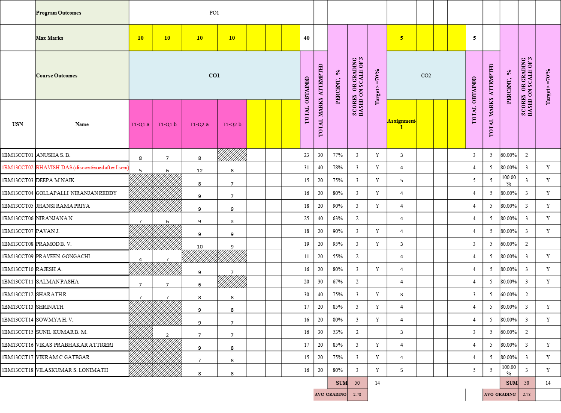
Example of CO-attainment for a course

Slide 74
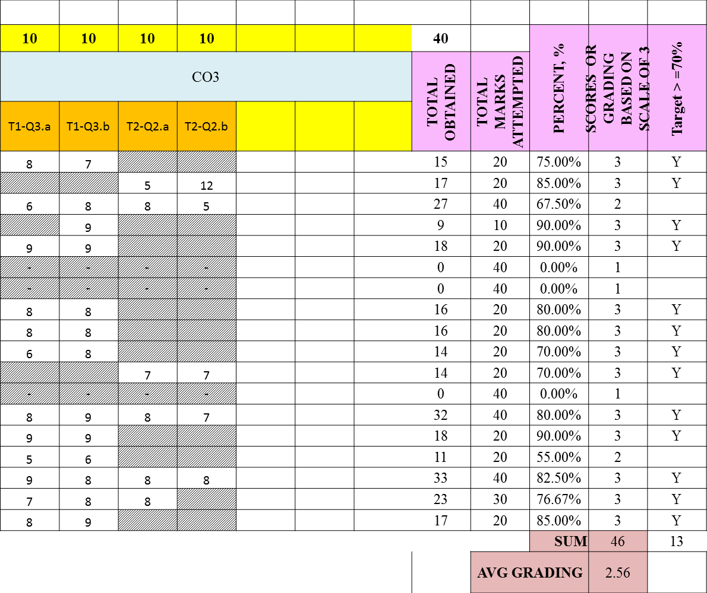
Example of CO-attainment for a course

Slide 75
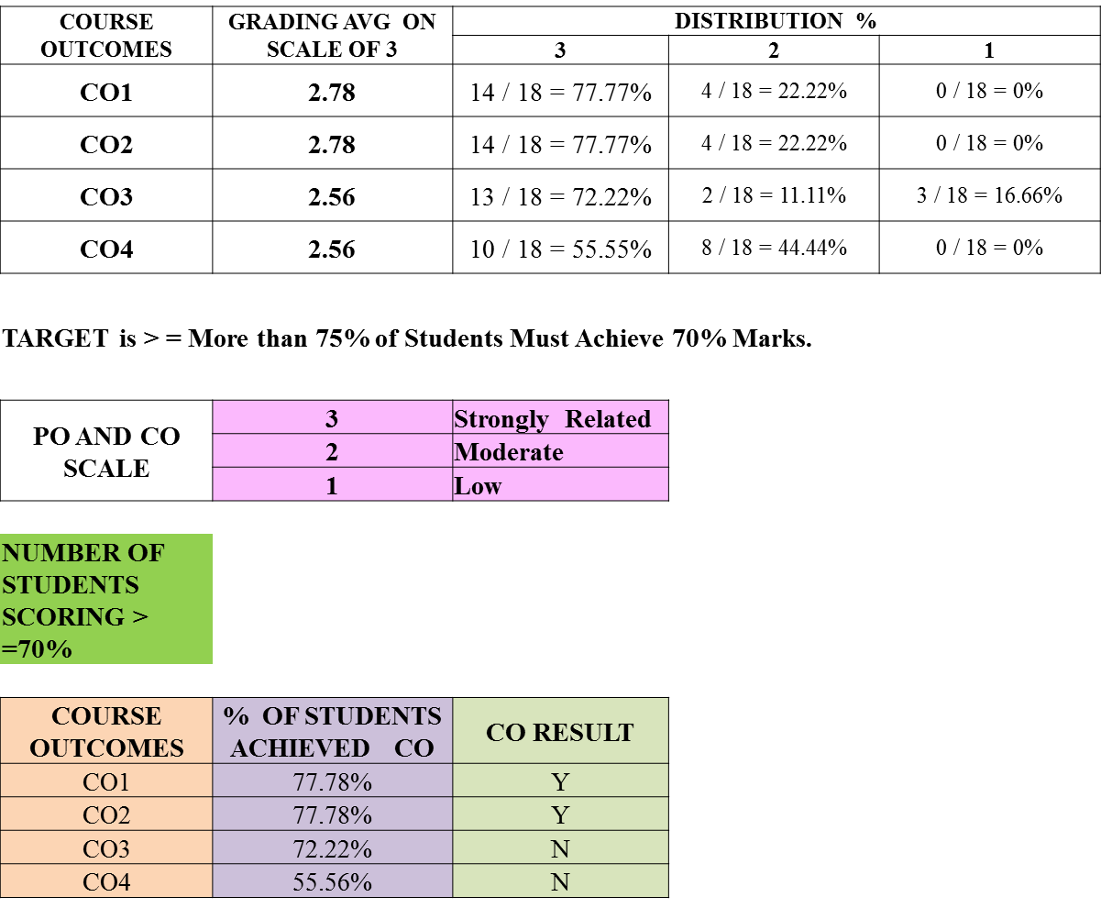
Example of CO-attainment for a course

Slide 76

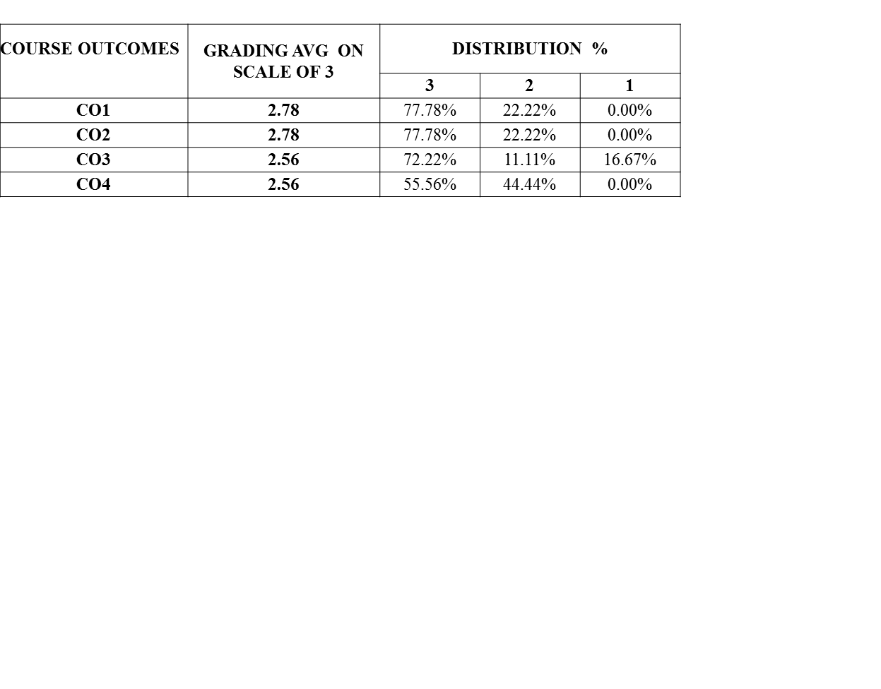


Example of CO-attainment for a course
GRADING AVG ON SCALE OF 3
2.80
2.75
2.70
AVERAGE GRADING
2.65
CO1 CO2 CO3
CO4
2.60
2.55
2.50
2.45
2.40
CO1
CO2 CO3
COURSE OUTCOME
CO4

Slide 77



CO Attainment
The assessments should be in alignment with the COs
Question paper should be so set to assess all COs
The average marks obtained in assessments against items for each CO will indicate the CO attainment.
Instructors can set targets for each CO of his/her course.
Attainment gaps can therefore be identified.
Instructor can plan to reduce the attainment gaps or enhance attainment targets.

Slide 78
3.3.1. Describe assessment tools and processes used for measuring the attainment of
Contd.
each of the Program Outcomes and Program Specific Outcomes
Describe the assessment tools and processes used to gather the data upon which the evaluation of each of the Program Outcomes and Program Specific Outcomes is based indicating the frequency with which these processes are carried out
Describe the assessment processes that demonstrate the degree to which the Program Outcomes and Program Specific Outcomes are attained and document the attainment levels
Exhibits/Context to be Observed/Assessed:
A.&B.
Direct and indirect assessment tools & processes ; effective compliance; direct assessment methodology, indirect assessment formats-collection analysis; decision making based on direct and indirect assessment

Slide 79
3.3.2. Provide results of evaluation of each PO & PSO
Contd.
Program shall set Program Outcome attainment levels for all POs and PSOs
The attainment levels by direct (student performance) and indirect (surveys) are to be presented through Program level Course-PO & PSO matrix as indicated
PO Attainment: Similar table is to be prepared for PSOs
Direct attainment level of a PO & PSO is determined by taking average across all courses addressing that PO and/or PSO.
Indirect attainment level of PO & PSO is determined based on the student exit surveys, employer surveys, co-curricular activities, extra-curricular activities etc.
Exhibits/Context to be Observed/Assessed:
A. & B. Appropriate attainment level and documentary evidences; details for POs & PSOs attainment from core courses to be verified. Also atleast two POs & two PSOs attainment levels shall be verified

Slide 80



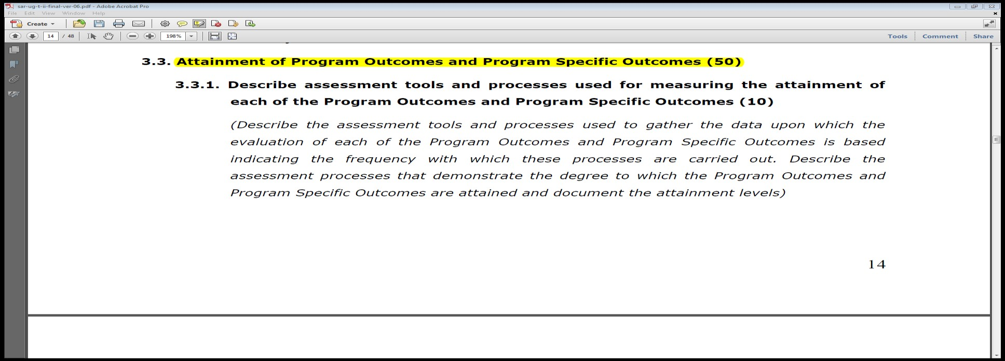
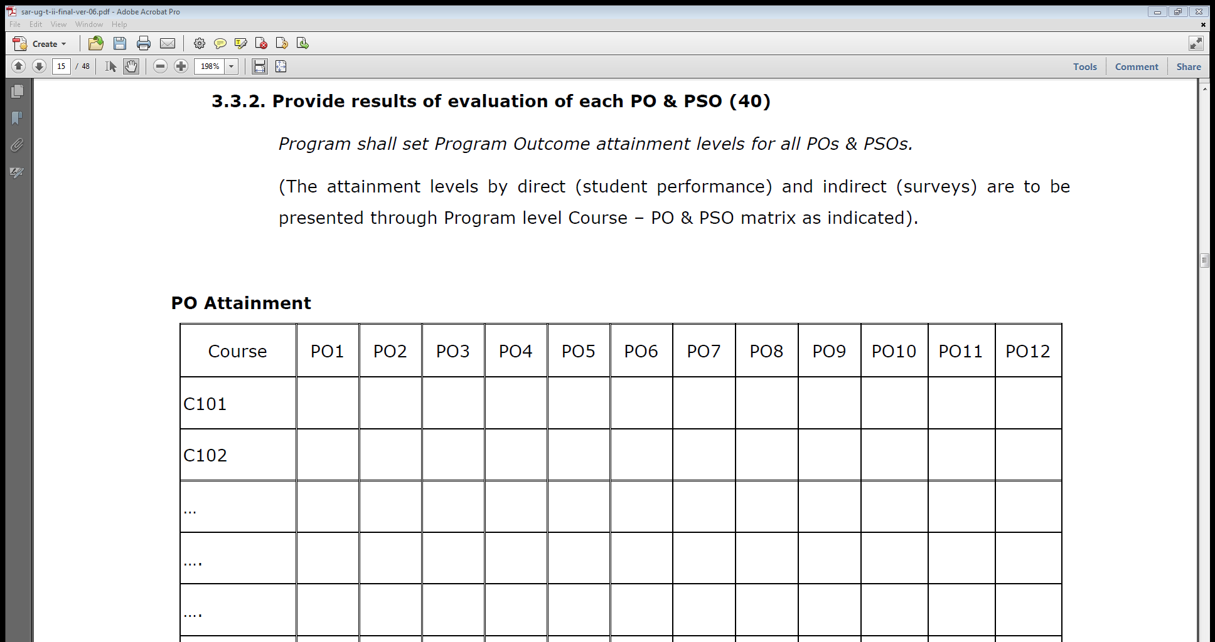
PO Attainment – Example..

Slide 81




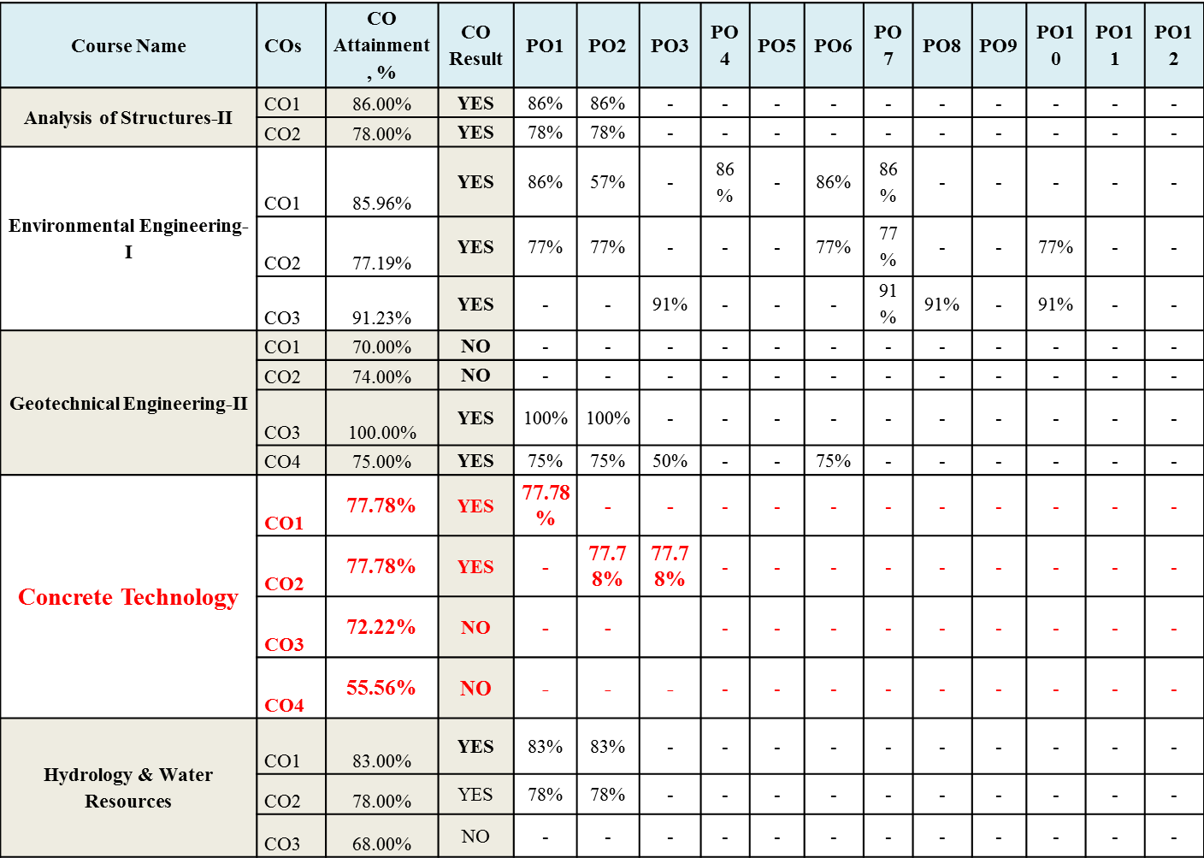
Attainment of Pos:

Slide 82

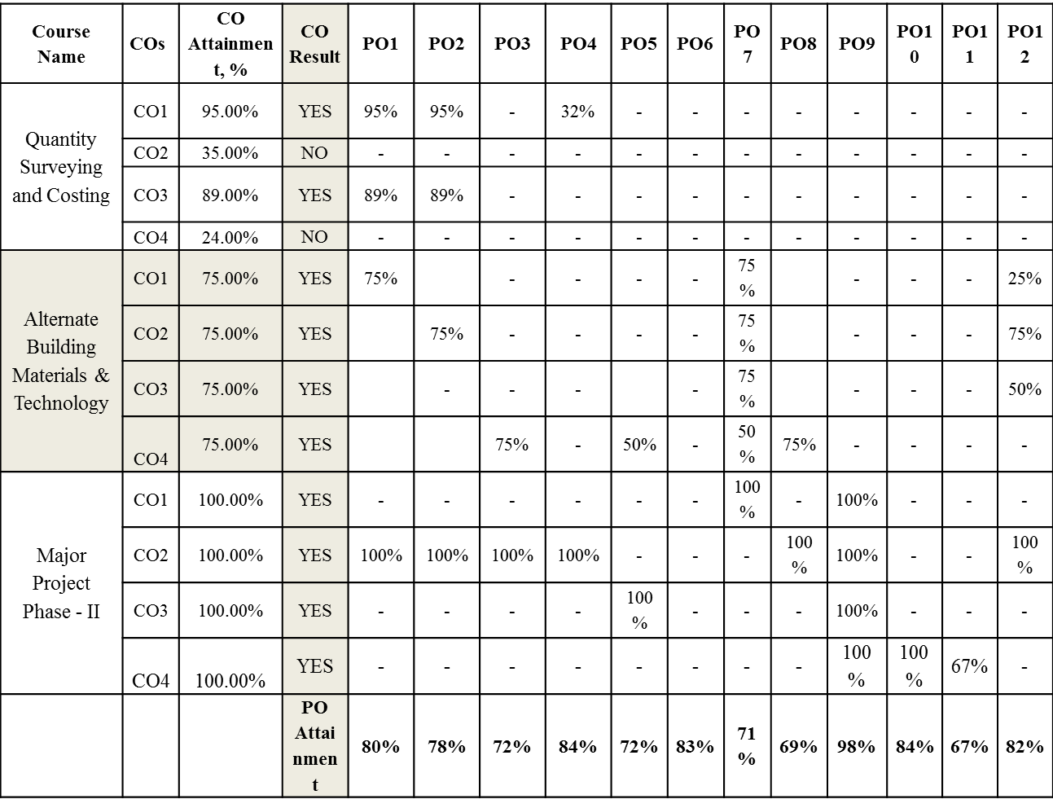
Contd…

Slide 83
Example Weightages for PO
PO No . | Attainment Method of Assessment | Dire ct Asse ssme nt (CIE ) | Direct Assess ment (SEE) | Stude nt Exit Surve y | Cours e End Surve y | Facu lty Surv ey | PO Attain ment, %
 | Weightage PO Description | 50% | 30% | 10% | 5% | 5%
PO 1 | Apply the knowledge of mathematics, science, engineering fundamentals, and an engineering specialization to the solution of complex engineering problems. | 38% | 22% | 7% | 4% | 4% | 76%
PO 2 | Identify, formulate, research literature, and analyz e complex engineering problems reaching substantiated conclusions using first principles of mathematics, natural sciences, and engineering sciences. | 37% | 22% | 7% | 4% | 4% | 75%
PO 3 | Design solutions for complex engineering problems and design system components or processes that meet the specified needs with appropriate consideration for the public health and safety, and the cultural, societal, and environmental considerations. | 32% | 23% | 7% | 3% | 3% | 68%
PO 4 | Use research based knowledge and research methods including design of experiments, analysis and interpretation of data, and synthesis of the information to provide valid conclusions. | 39% | 23% | 7% | 4% | 3% | 77%

Slide 84



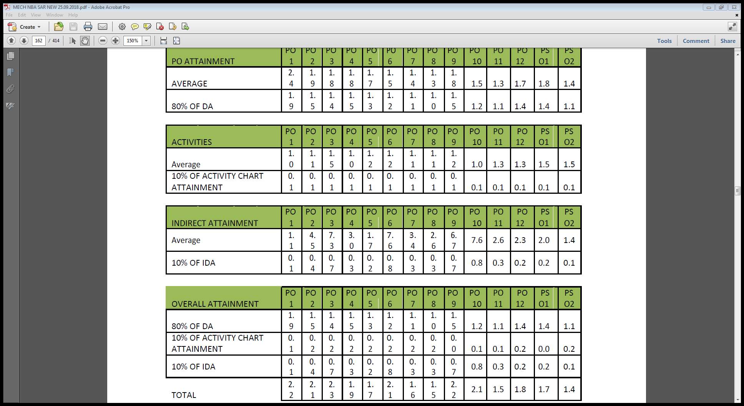
PO-Attainment: What next ?

Slide 85

PO Attainment
All POs can be adequately addressed through the selection of core courses and their COs
Attainable targets can be selected for each of the CO.
If assessment is in alignment with COs the performance of the students indicates the CO attainment.
These measurements provide the basis for continuous improvement in the quality of learning.

Slide 86
CRITERION 4: Students’ Performance
 | Item (Information-cumulatively for all the shifts with explicit headings) | CAY | CAYm1 | CAYm2
 | Sanctioned intake of the program (N)
 | Total number of students admitted in first year minus number of students migrated to other programs/institutions plus no. of students migrated to this program (N1)
 | Number of students admitted in 2nd year in the same batch via lateral entry (N2)
 | Separate division students, if applicable (N3)
 | Total number of students admitted in the Program (N1 + N2 + N3)

Slide 87
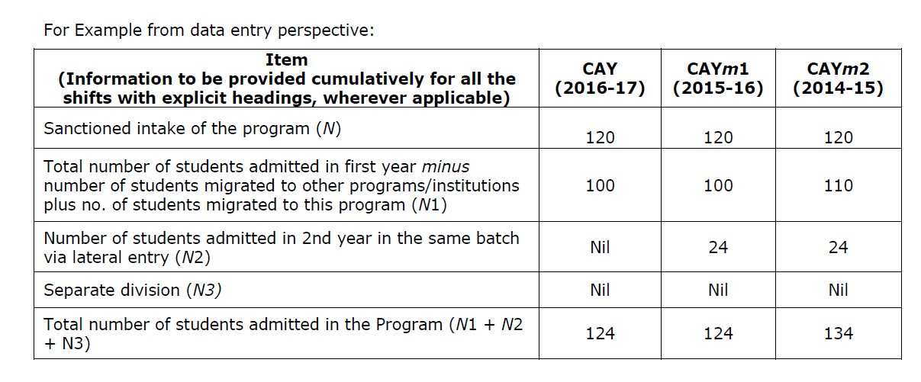
Data Entry
100

Slide 88
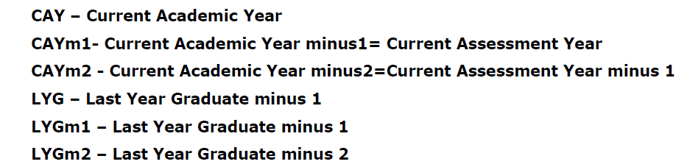
Contd.
 |  | N1 + N2 + N3 | Number of students who have successfully graduated without backlogs in any semester /
 |  | (As defined above) | (Without Backlog means no compartment or failures in any semester/year of study)
 |  |  | I Year | II Year | III Year | IV Year
 | CAY
 | CAYm1
 | CAYm2
 | CAYm3 (LYG)
 | CAYm4 (LYGm1)
 | CAYm5 (LYGm2)
Year of entry
year of study

Slide 89
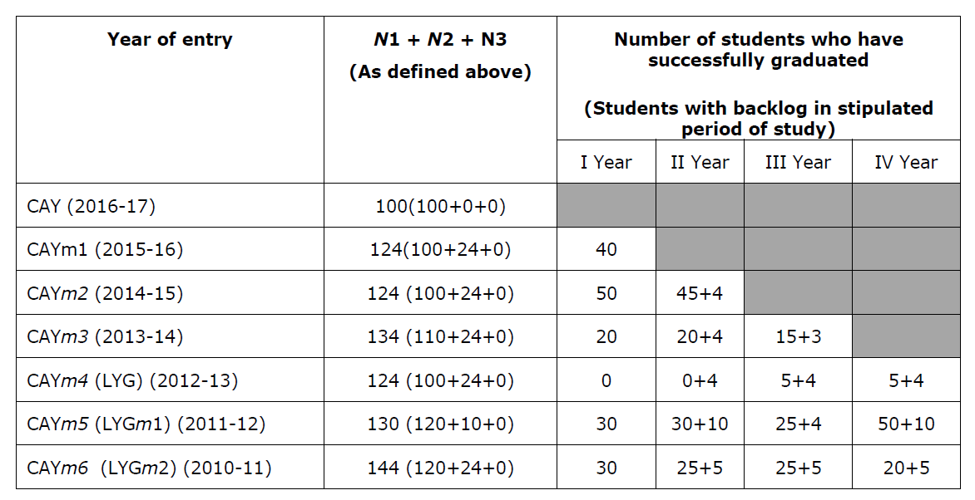

Slide 90
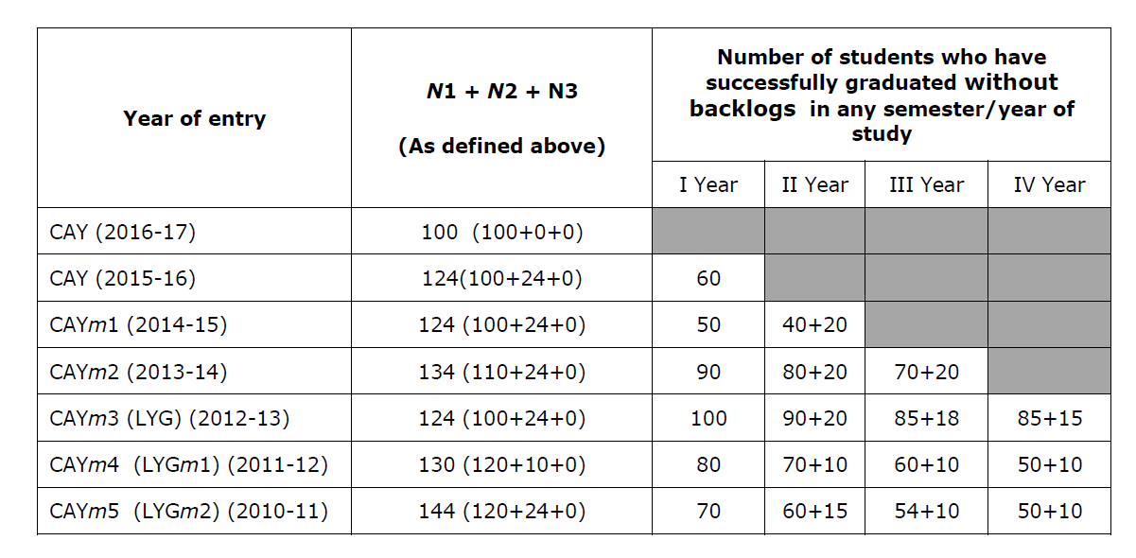


Slide 91
4.1. Enrolment Ratio (20)
Contd.
Enrolment Ratio= N1(Admitted)/N (Sanctioned)
Item (Students enrolled at the First Year Level on average basis during the period of assessment) | Marks
>= 90% students | 20
>= 80% students | 18
>= 70% students | 16
>= 60% students | 14
Otherwise | 0
Exhibits/Context to be Observed/Assessed:
A. B. & C. Data to be verified for each of the assessment years

Slide 92
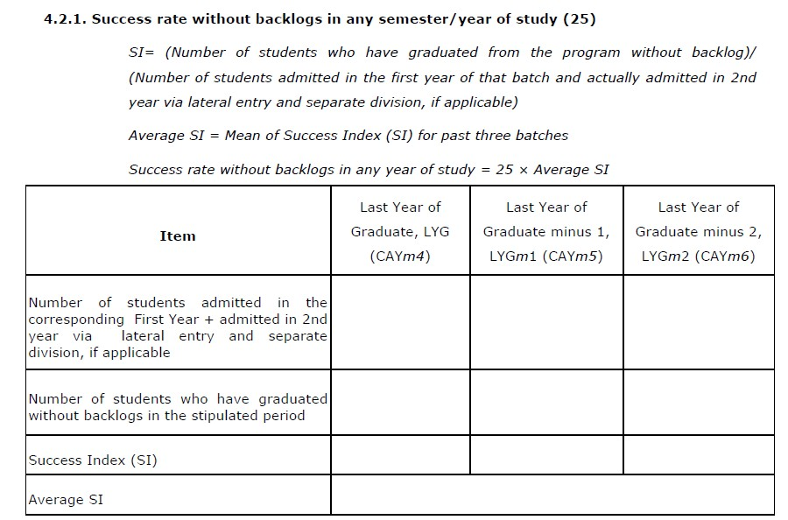
Contd.
Exhibits/Context to be Observed/Assessed:
Data to be verified for each of the assessment years

Slide 93
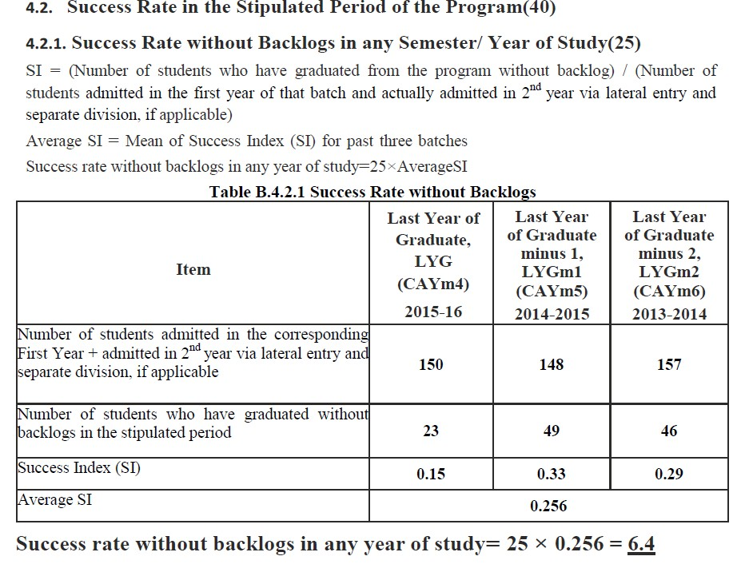

Slide 94
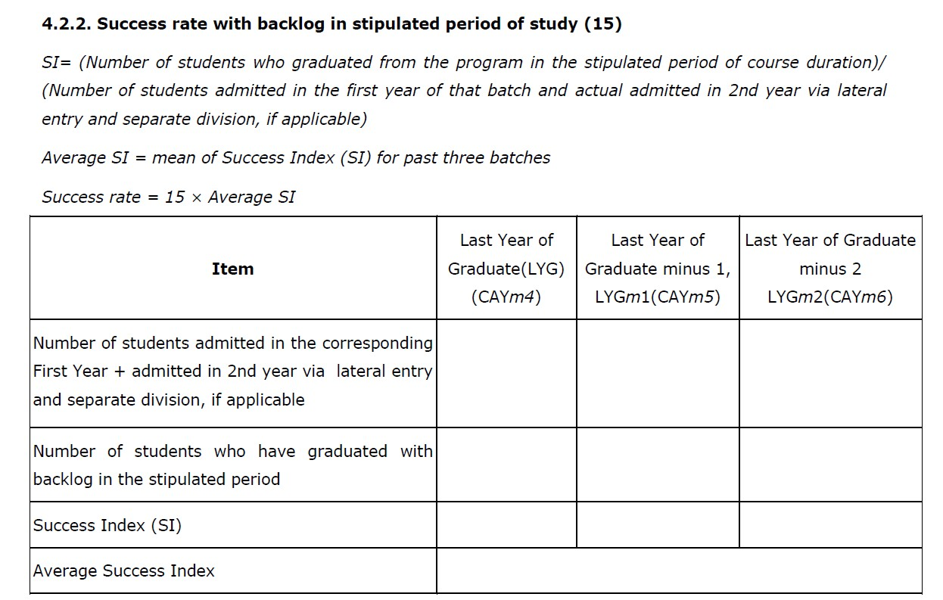
Contd.
Exhibits/Context to be Observed/Assessed:
Data to be verified for each of the assessment years
Note: If 100% students clear without any backlog then also total marks scored will be 40 as
both 4.2.1 & 4.2.2 will be applicable simultaneously.

Slide 95
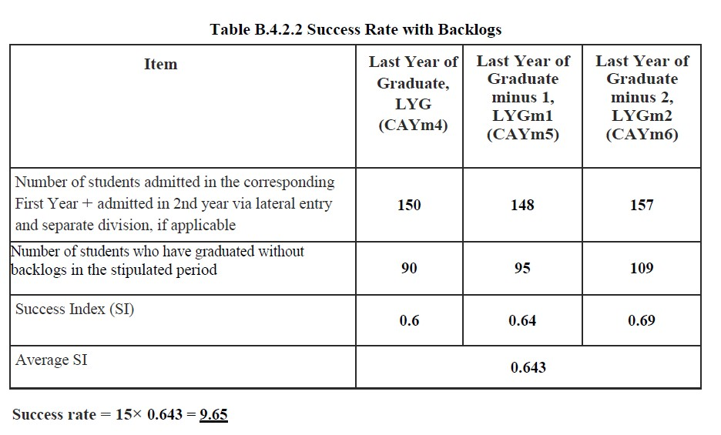

Slide 96
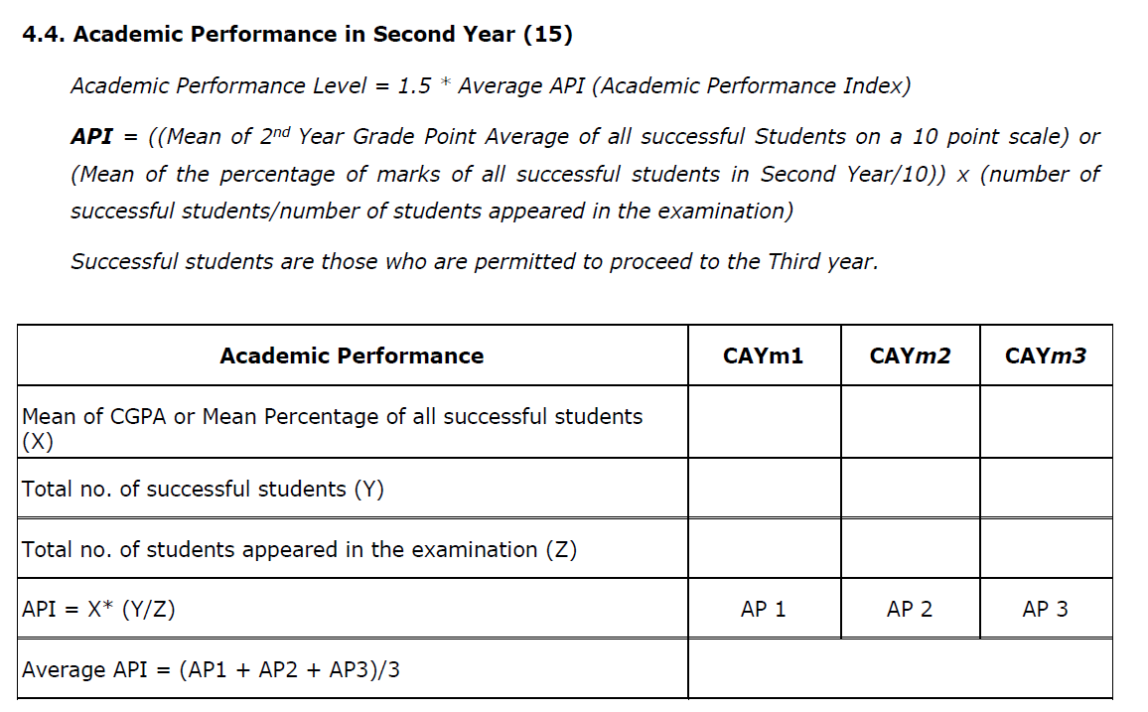
Contd.
Exhibits/Context to be Observed/Assessed:
Data to be verified for atleast one of the assessment years.

Slide 97
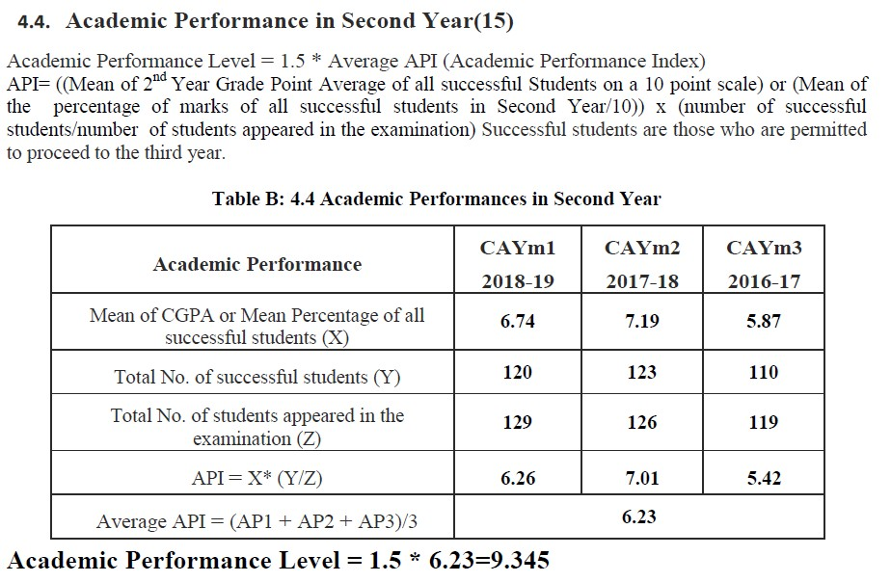

Slide 98
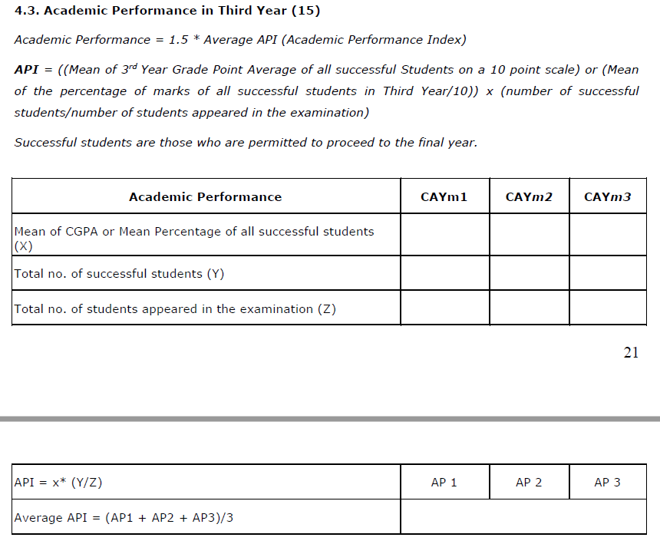
Cont
d.
Exhibits/Context to be Observed/Assessed:
Data to be verified for atleast one of the assessment years.

Slide 99
4.5. Placement, Higher Studies and Entrepreneurship
Contd.
Assessment Points = 40 × average placement
Item | CAY | CAYm1 | CAYm2
Total No. of Final Year Students (N)
No. of students placed in companies or Government Sector (x)
No. of students admitted to higher studies with valid qualifying scores (GATE or equivalent State or National Level Tests, GRE, GMAT etc.) (y)
No. of students turned entrepreneur in engineering / technology (z)
x + y + z =
Placement Index : (x + y + z )/N | P1 | P2 | P3
Average placement= (P1 + P2 + P3)/3
Exhibits/Context to be Observed/Assessed:
Data to be verified for atleast one of the assessment years.

Slide 100
4.6. Professional Activities
Contd.
    Professional societies/chapters and organizing engineering events Relevant documentary evidences
      Professional Society/Chapters
      No. and Quality of Engineering events organized (Level - Institute/State/National/International)
Exhibits/Context to be Observed/Assessed:
Self -Explanatory.
    Publication of technical magazines, newsletters, etc.
The Department publications along with the names of the editors, publishers, etc.
      Quality and relevance of the contents and print material
      Participation of students from the program

Slide 101
Exhibits/Context to be Observed/Assessed:
Contd.
Documentary evidence
Documentary evidence - Students participation (also to be confirmed during interaction with the students)
    Participation in inter-institute events by students of the program of study Awards in the events/conferences organized by other institutes
      Within the State
      Outside the State
      Prized/Awards received
Exhibits/Context to be Observed/Assessed:
A.B.& C. Quality of events and documentary evidence

Slide 102
 |  |  | Name of the Faculty Member
 |  |  | Degree (highest degree) | Qualification
 |  |  | University
 |  |  | Year of attaining higher qualification
 |  |  | Association with the Institution
 |  |  | Designation
 |  |  | Date on which Designated as Professor/ Associate Professor
 |  |  | Date of Joining the Institution
 |  |  | Department
 |  |  | Specialization
 |  |  | Research Paper Publications |  | Academic
 |  |  | Ph.D. Guidance
 |  |  | Faculty Receiving Ph.D. during the Assessment Years
 |  |  | Currently Associated (Y/N) Date of Leaving (In case Currently Associated is (“No”)
 |  |  | Nature of Association (Regular/Contract)
CRITERION 5: Faculty Information and Contributions
Research

Slide 103
5.1. Student-Faculty Ratio (SFR)
Contd.
(To be calculated at Department Level)
No. of UG Programs in the Department (n):
No. of PG Programs in the Department (m):
No. of Students in UG 2nd Year= u1 No. of Students in UG 3rd Year= u2 No. of Students in UG 4th Year= u3 No. of Students in PG 1st Year= p1 No. of Students in PG 2nd Year= p2
No. of Students = Sanctioned Intake + Actual admitted lateral entry students (The above data to be provided considering all the UG and PG programs of the department) S=Number of Students in the Department = UG1 + UG2 +… +UGn + PG1 + …PGn
F = Total Number of Faculty Members in the Department (excluding first year faculty)
Student Teacher Ratio (STR) = S / F

Slide 104
 | Year | CAY | CAYm1 | CAYm2
 | u1.1
 | u1.2
 | u1.3
 | UG1 | u1.1+u1.2+u1.3 | u1.1+u1.2+u1.3 | u1.1+u1.2+u1.3
 | …
 | un.1
 | un.2
 | un.3
 | UGn | un.1+un.2+un.3 | un.1+un.2+un.3 | un.1+un.2+un.3
 | p1.1
 | p1.2
 | PG1 | p1.1+p1.2 | p1.1+p1.2 | p1.1+p1.2
 | …..
 | pm.1
 | pm.2
 | PGm | pn.1+pn.2 | pn.1+pn.2 | pn.1+pn.2
 | Total No. of Students in the Department (S) | UG1 + UG2 +.. +UGn + PG1 + …PGn | UG1 + UG2 + .. +UGn + PG1+… + PGn | UG1 + UG2 + .. +UGn + PG1+… + PGn
 | No. of Faculty in the Department (F) | F1 | F2 | F3
 | Student Faculty Ratio (SFR) | SFR1=S1/F1 | SFR2= S2/F2 | SFR3= S3/F3
 | Average SFR | SFR=(SFR1+SFR2+SFR3)/3

Slide 105
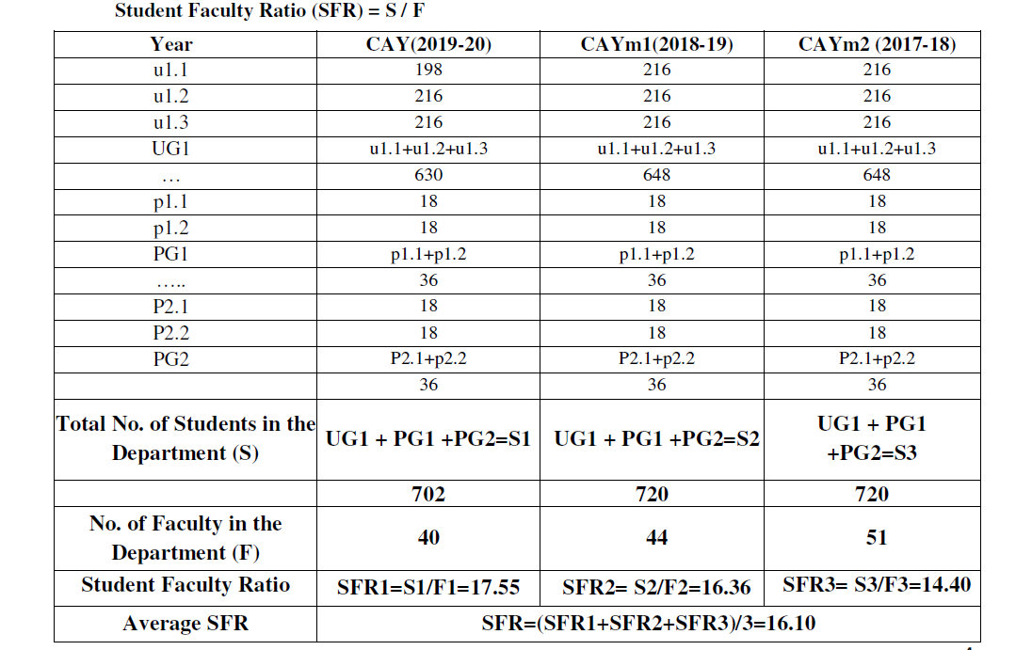

Slide 106
* REGULAR Means –
Contd.
Full time on roll with prescribed pay scale. An employee on contract for a period of more than two years AND drawing consolidated salary equal or higher than applicable gross salary shall only be counted as a regular employee
Prescribed pay scales means pay scales notified by the AICTE/Central Government and implementation as prescribed by the State Government. In case State Government prescribes lesser consolidated salary for a particular cadre then same will be considered as reference while counting faculty as a regular faculty

Slide 107
Guidelines for Faculty:
The PhD faculty count requirement shall be calculated on the pro-rota basis – with at least 75% to be part of the regular faculty, and the remaining being part of the contractual* faculty, if any. *(Only those who have taught for consecutive 2 semesters on full time basis)
The contractual faculty (doing away with the terminology of visiting/adjunct faculty, whatsoever) who have taught for 2 consecutive semesters in the corresponding academic year on full time basis shall be considered for the purpose of calculation in the Student Faculty Ratio.
If a member of regular or contractual faculty is designated as lecturer, even though holding an M.Tech degree, NBA shall not count him/her against the faculty requirements.
In the multidisciplinary areas (like MBA or PGDM) or specialized areas like Biotechnology, all the qualifications relevant and purposeful to those disciplines need to be considered, in addition to the M.Tech/MBA/PGDM degrees.

Slide 108
There is no age limit to the consideration for the emeritus faculty as long as they are physically fit to take classes and engage with students, and are employed on a full time basis.
Regular faculty to be counted if completed 9 months for the current academic year.
NOTE: Kindly note that the year mentioned here is exemplary, institute has to consider the academic years as per the definition of CAY given in the document and according to the prevailing year.
CAY: Current Academic Year
CAYm1: Current Academic Year minus 1 = Current Assessment Year
CAYm2: Current Academic Year minus 2 = Current Assessment Year minus1
Academic year is considered from July to June.

Slide 109
Marks to be given proportionally from a maximum of 20 to a minimum of 10 for average SFR between 20:1 to 25:1, and zero for average SFR higher than 25:1. Marks distribution is given as below:
< = 20 -
< = 25 -
> 25 -
20 Marks
10 Marks
0 Marks
Exhibits/Context to be Observed/Assessed:
SFR is to be verified considering the faculty of the entire department.
No. of Regular faculty calculation considering Regular faculty definition*; Faculty appointment letters, time table, subject allocation file, salary statements.
No. of students calculation as mentioned in the SAR(please refer table under criterion 5.1) Faculty Qualification as per AICTE guidelines shall only be counted
* Note: Minimum 75% should be Regular/ full time faculty and the remaining shall be Contractual Faculty as per AICTE norms and standards.
The contractual faculty (doing away with the terminology of visiting/adjunct faculty, whatsoever) who have taught for 2 consecutive semesters in the corresponding academic year on full time basis shall be considered for the purpose of calculation in the Student Faculty Ratio.
•
•

Slide 110

5.2. Faculty Cadre Proportion
Contd.
The reference Faculty cadre proportion is 1(F1):2(F2):6(F3)
If AF1 = AF2= 0 then zero marks
Maximum marks to be limited if it exceeds 25
Example: Intake = 180; Required number of Faculty: total students as per 5.1/20
=702/20 = 35., ; RF1= 1/9 x35 =4, RF2=2/9x35=8 and RF3=6/9x35= 23.
Case 1: AF1/RF1= 1; AF2/RF2 = 1; AF3/RF3 = 1;
Cadre proportion marks = (1+0.6+0.4) x12.5 = 25
Case 2: AF1/RF1= 1; AF2/RF2 = 9/8; AF3/RF3 = 22/23;
Cadre proportion marks = (1+0.7+0.4) x12.5 = limited to 25
Case 3: AF1/RF1=0; AF2/RF2=1/2; AF3/RF3=11/9; To be observed carefully
Cadre proportion marks = (0+0.3+0.49) x12.5 = 9.87

Slide 111
Exhibits/Context to be Observed/Assessed:
(Faculty Qualification and experience required for cadre posts shall only be considered as per AICTE
norms/guidelines)
Cadre wise
No. of faculty available; Faculty qualification and experience and eligibility;
Appointment/Promotion orders
Cadre wise no. of faculty required as per AICTE guidelines (refer calculation in SAR)

Slide 112
5.3. Faculty Qualification
Contd.
FQ = 2.5 x [{10X +4Y}/F] where
X is no. of faculty with Ph.D., Y is no. of faculty with M.Tech,
F is no. of faculty required to comply 1:20 Faculty Student ratio
(no. of faculty and no. of students required to be calculated as per 5.1)
Exhibits/Context to be Observed/Assessed:
Documentary evidence – Faculty Qualification

Slide 113
5.4. Faculty Retention
Contd.
No. of regular faculty members in CAYm2= CAYm1= CAY=
Item (During the period of assessment keeping CAYm2 as base year) | Marks
>=90% of required Faculty members retained | 25
>=75% of required Faculty members retained | 20
>=60% of required Faculty members retained | 15
>=50% of required Faculty members retained 10 | 10
<50% of required Faculty members retained | 0
Exhibits/Context to be Observed/Assessed:
Faculty date of joining; atleast three month (July-April-May) salary statement for each of the assessment years

Slide 114
5.5. Innovations by the Faculty in Teaching and Learning
Contd.
Contributions to teaching and learning are activities that contribute to the improvement of student learning. These activities may include innovations not limited to-
Use of ICT
Instruction delivery
Instructional methods
Assessment
Evaluation and inclusive class rooms that lead to effective, efficient and
engaging instruction
Exhibits/Context to be Observed/Assessed:
Availability on Institute website; awareness among faculty and students of the department
& C. Self –explanatory
D. Innovations that contribute to the improvement of student learning, typically include use of ICT, instruction delivery, instructional methods, assessment, evaluation etc.

Slide 115
5.6. Faculty as participants in Faculty development / training activities/ STTPs
Contd.
A Faculty scores maximum five points for participation
Participation in 2 to 5 days Faculty development program: 3 Points
Participation >5 days Faculty development program: 5 points
Name of the Faculty | Max. 5 per Faculty
 | CAY | CAYm1 | CAYm2
Sum
RF= Number of Faculty required to comply with 20:1 Student-Faculty ratio as per 5.1
Assessment = 3 × (Sum/0.5RF) (Marks limited to 15)
Average assessment over three years (Marks limited to 15) =
Exhibits/Context to be Observed/Assessed:
Relevance of the training/development programme
No. of days; No. of faculty

Slide 116
5.7. Research and Development
Contd.
5.7.1. Academic Research
Academic research includes research paper publications, Ph.D. guidance, and faculty receiving Ph.D. during the assessment period.
Number of quality publications in refereed/SCI Journals, citations, Books/Book Chapters etc.
Ph.D. guided /Ph.D. awarded during the assessment period while working in the institute
Exhibits/Context to be Observed/Assessed:
  Quality of publications; publications copy
  Documentary evidence

Slide 117
5.7.2. Sponsored Research
Contd.
Funded research from outside
Provide a list with Project Title, Funding Agency, Amount and Duration
Funded research from outside; Cumulative during CAYm1, CAYm2 and CAYm3
Amount > 20 Lakh
5 Marks
4 Marks
3 Marks
2 Marks
  1 Mark
  0 Mark
Amount >= 16 Lakh and <= 20 Lakh
Amount >= 12 Lakh and <
16 Lakh
12 Lakh
8 Lakh
Amount >= 8
Amount >= 4
Lakh and < Lakh and <
Amount < 4 Lakh
Exhibits/Context to be Observed/Assessed:
Documentary evidence; Funding agency, Amount, Duration, Research progress; Outcome

Slide 118
5.7.3. Development activities
Contd.
Provide details:
Product Development
Research laboratories
Instructional materials
Working models/charts/monograms etc.
Exhibits/Context to be Observed/Assessed:
Self explanatory
5.7.4. Consultancy (from Industry)
Provide a list with Project Title, Funding Agency, Amount and Duration
Consultancy; (Cumulative during CAYm1, CAYm2 and CAYm3)
Amount > 10 Lakh |  |  |  | – 5 Marks
Amount >= 8 Lakh and |  | <= | 10 Lakh | – 4 Marks
Amount >= 6 Lakh and < |  | 8 | Lakh | – 3 Marks
Amount >= 4 Lakh and < |  | 6 | Lakh | – 2 Marks
Amount >= 2 Lakh and < |  | 4 | Lakh | – 1 Mark
Amount < | 2 Lakh | – 0 Mark

Slide 119
Contd.
Exhibits/Context to be Observed/Assessed:
Documentary evidence; Funding agency, Amount, Duration, Research progress; Outcome
5.8. Faculty Performance Appraisal and Development System (FPADS)
The assessment is based on:
A well-defined system for faculty appraisal for all the assessment years
Its implementation, transparency and effectiveness
Exhibits/Context to be Observed/Assessed:
Notified performance appraisal and development system; Appraisal Parameters; Awareness
Implementation, Transparency and Effectiveness

Slide 120
5.9. Visiting/Adjunct/Emeritus Faculty etc.
Contd.
Adjunct faculty also includes Industry experts. Provide details of participation and contributions in teaching and learning and /or research by visiting / adjunct / Emeritus faculty etc. for all the assessment years:
Provision of inviting visiting/adjunct /Emeritus faculty
Minimum 50 hours per year interaction with adjunct faculty from industry/retired professors etc.
Exhibits/Context to be Observed/Assessed:
Documentary evidence

Slide 121
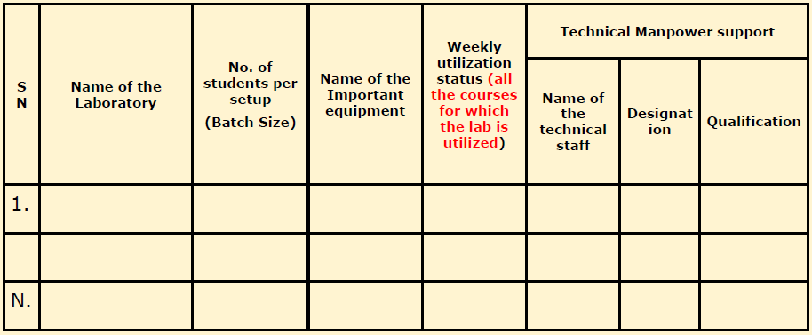
CRITERION 6: Facilities and Technical Support
6.1. Adequate and well equipped laboratories, and technical manpower
Adequate well-equipped laboratories to run all the program- specific curriculum (20)
Availability of adequate technical supporting staff (5)
Availability of qualified technical supporting staff (5)
Exhibits/Context to be Observed/Assessed:
  Adequacy; well-equipped laboratories; utilization
  & C. Self - explanatory

Slide 122
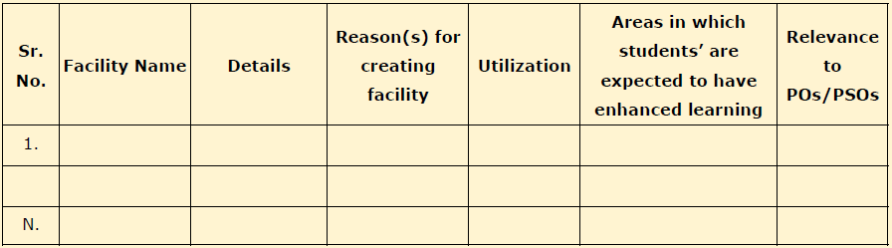
6.2. Additional facilities created for improving the quality of learning experience in laboratories
Contd.
Availability and relevance of additional facilities(10)
Facilities utilization and effectiveness (10)
Relevance to POs and PSOs (5)
Exhibits/Context to be Observed/Assessed:
Self-explanatory
6.3. Laboratories: Maintenance and overall ambiance
Maintenance and overall ambience Self-Explanatory

Slide 123
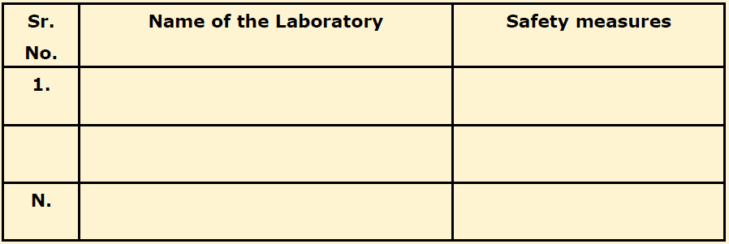
6.4. Project laboratory
Contd.
Mention facility & Utilization
6.5. Safety measures in laboratories

Slide 124
7.1. Actions taken based on the results of evaluation of each of the POs & PSOs
CRITERION 7: Continuous Improvement
Identify the areas of weaknesses in the program based on the analysis of evaluation of POs & PSOs attainment levels
Measures identified and implemented to improve POs & PSOs attainment levels for the assessment years
Examples of analysis and proposed action Sample 1:
Course outcomes for a laboratory course did not measure up, as some of the lab equipment did not have the capability to do the needful (e.g., single trace oscilloscopes available where dual trace would have been better, or, non
availability of some important support software etc.)
Action taken-Equipment up-gradation was carried upgradation)
out (with details of

Slide 125
Sample 2:
Contd.
In a course on EM theory student performance has been consistently low with respect to some COs
Analysis of answer scripts and discussions with the students revealed that this could be attributed to a weaker course on vector calculus
Action taken-revision of the course syllabus was carried out (instructor/text book changed too has been changed, when deemed appropriate)
Sample 3:
In a course that had group projects it was determined that the expectations from this course about PO3 (like: “to meet the specifications with consideration for the public health and safety, and the cultural, societal, and environmental considerations”) were not realized as there were no discussions about these aspects while planning and execution of the project
Action taken- Project planning, monitoring and evaluation included in rubrics related to these aspects

Slide 126
Contd. POs & PSOs Attainment Levels and Actions for improvement – CAY
 |  | Target | Attainment | Observations
 |  | Level | Level
 | PO1: Engineering knowledge: Apply the knowledge of mathematics, science, engineering fundamentals, and an engineering specialization to the solution of complex engineering problems.
 | Action 1: Action n:
 | PO2: Problem analysis: Identify, formulate, research literature, and analyze complex engineering problems reaching substantiated conclusions using first principles of mathematics, natural sciences, and engineering Sciences
Similar Tables should be presented for all POs & PSOs Exhibits/Context to be Observed/Assessed: Documentary evidence in respect of each of the POs

Slide 127
7.2. Academic Audit and actions taken thereof during the period of Assessment
Contd.
Assessment shall be based on conduct and actions taken in relation to Continuous Improvement
Exhibits/Context to be Observed/Assessed:
Academic Audit assessment criteria, frequency, conduct mechanism, action plan based on audit, implementation and effectiveness
  Improvement in Placement, Higher Studies and Entrepreneurship
Assessment is based on improvement in:
    Placement: number, quality placement, core industry, pay packages etc.
    Higher studies: performance in GATE, GRE, GMAT, CAT etc., and admissions in premier institutions
    Entrepreneurs
Exhibits/Context to be Observed/Assessed:
A. B. & C. Nos. in each year of the assessment; improvement considering CAYm3 as a base year

Slide 128
7.4. Improvement in the quality of students admitted to the program
Contd.
Assessment is based on improvement in terms of ranks/score in qualifying-
State level/National level entrances tests
Percentage marks in Physics, Chemistry and Mathematics in 12th Standard
Percentage marks of the lateral entry students
Exhibits/Context to be Observed/Assessed:
A. Documentary evidence – list of students admitted; admission authority guidelines; ranks/scores;
comparative status considering CAYm3 as a base year

Slide 129
CRITERION 8: First Year Academics
8.1. First Year Student-Faculty Ratio (FYSFR)
Assessment = (5 × 15)/Average FYSFR (Limited to Max. 5)
For each year of assessment = (5 × 20)/ FYSFR
(Limited to Max. 5) Average of Assessment of data in CAY, CAYm1 and CAYm2
*Note: If FYSFR is greater than 25, then assessment equal to zero.
Exhibits/Context to be Observed/Assessed:
No. of Regular faculty calculation considering Regular faculty definition and appointment letters; Salary statements
No. of students calculation as mentioned in the SAR
fractional load; Faculty

Slide 130
8.2. Qualification of Faculty Teaching First Year Common Courses
CRITERION 8: First Year Academics
Assessment of qualification = (5x +3y)/RF x= Number of Regular Faculty with Ph.D
y = Number of Regular Faculty with Post-graduate qualification RF= Number of faculty members required as per SFR of 20:1
Exhibits/Context to be Observed/Assessed:
Documentary evidence – Faculty Qualification
8.3. First Year Academic Performance
Academic Performance = ((Mean of 1st Year Grade Point Average of all successful Students on a 10 point scale) or (Mean of the percentage of marks in First Year of all successful students/10)) x (number of successful students/number of students appeared in the examination)
Successful students are those who are permitted to proceed to the Second year
Exhibits/Context to be Observed/Assessed:
Data to be verified for atleast one of the assessment years

Slide 131
8.4. Attainment of Course Outcomes of first year courses
Contd.
    Describe the assessment processes used to gather the data upon which the evaluation of Course Outcomes of first year is done
Examples of data collection processes may include, but are not limited to –
      Specific exam questions
      Laboratory tests
      Internally developed assessment exams
      Oral exams
      Assignments
      Presentations
      Tutorial sheets etc.
Exhibits/Context to be Observed/Assessed:
A. & B. Direct and indirect assessment(if applicable), tools & processes; effective compliance; direct assessment methodology, indirect assessment formats-collection-analysis; decision making

Slide 132
8.4.2. Record the attainment of Course Outcomes of all first year courses
Contd.
Program shall have set attainment levels for all first year courses.
The attainment levels shall be set considering average performance levels in the University Examination or any higher value set as target for the assessment years.
Attainment level is to be measured in terms of student performance in internal assessments with respect the COs of a subject plus the performance in the University examination
A. Verify the records as per the benchmark set for the courses (5)
Exhibits/Context to be Observed/Assessed:
Documentary evidence – Attainment for atleast 3 courses

Slide 133
8.5. Attainment of Program Outcomes of all first year courses
Contd.
    Indicate results of evaluation of each relevant PO and/or PSO, if applicable
      The relevant program outcomes that are to be addressed at first year need to be
identified by the institution
      Program Outcome attainment levels shall be set for all relevant POs and/or PSOs through first year courses
COURSE | COs | PO1 | PO2 | PO3 | PO4 | PO5 | PO6 | PO7 | PO8 | PO9 | PO10 | PO11
C101
C102
...
...
Direct Attainment
Exhibits/Context to be Observed/Assessed:
A. & B. Documentary evidence for each relevant PO/PSO

Slide 134
8.5.2. Actions taken based on the results of evaluation of relevant POs
Contd.
The attainment levels by direct (student performance) are to be presented through
Program level Course-PO matrix as indicated
PO Attainment Levels and Actions for improvement CAY
 | Target Level | Attainment Level | Observations
PO1: Engineering knowledge: Apply the knowledge of mathematics, science, engineering fundamentals, and an engineering specialization to the solution of complex engineering problems.
Action 1: Action n:
PO2: Problem analysis: Identify, formulate, research literature, and analyze complex engineering problems reaching substantiated conclusions using first principles of mathematics, natural sciences, and engineering Sciences
Note: PSOs, if applicable to be added appropriately
Exhibits/Context to be Observed/Assessed:
A. & B. Documentary evidence for each relevant PO/PSO

Slide 135
CRITERION 9: Student Support Systems
  Mentoring system to help at individual level
    Type of mentoring: Professional guidance / career advancement / course work specific /
laboratory specific / all-round development
    Number of faculty mentors
    Number of students per mentor
    Frequency of meeting
Exhibits/Context to be Observed/Assessed:
A. Mentoring system terms of reference; implementation; effectiveness (also to be verified during interaction with the students)

Slide 136
CRITERION 9: Student Support Systems
  Feedback analysis and reward /corrective measures taken, if any
    Feedback collected for all courses: YES/NO
    Feedback questionnaire
    Specify the feedback collection process
    Average Percentage of students who participated
    Specify the feedback analysis process
    Basis of reward / corrective measures, if any: Indices used for measuring quality of teaching and learning
    Summary of the index values for all courses/teachers
    Number of corrective actions taken
Exhibits/Context to be Observed/Assessed:
A. Feedback questions, collection process, analysis, actions taken, effectiveness

Slide 137
9.3. Feedback on facilities
Contd.
Assessment is based on -
Feedback collection
Analysis and corrective action taken
9.4. Self Learning
The institution needs to specify –
Facilities
Materials
Scope for self-learning / learning beyond syllabus
Webinars
Podcast
MOOCs
Evaluate effectiveness

Slide 138
9.5. Career Guidance, Training, Placement
Contd.
The institution may specify –
Facility
Management
Effectiveness for career guidance including counseling for higher studies
Campus placement support
Industry interaction for training/internship/placement, etc.
Exhibits/Context to be Observed/Assessed:
Availability, implementation, effectiveness (also to be verified during interaction with the students)
9.6. Entrepreneurship Cell
The institution may specify –
Facility
Management
Effectiveness in encouraging entrepreneurship and incubation
Success stories for each of the assessment years
Exhibits/Context to be Observed/Assessed:
Availability, implementation, effectiveness (also to be verified during interaction with the students)

Slide 139
9.7. Co-curricular and Extra-curricular Activities
Contd.
The institution may specify –
Co-curricular and extra-curricular activities
Availability of sports and cultural facilities (3)
NCC, NSS and other clubs (3)
Annual students activities (4)
Exhibits/Context to be Observed/Assessed:
Availability, implementation, effectiveness (also to be verified during interaction with the students)

Slide 140
CRITERION 10: Governance, Institutional Support and Financial Resources
  Organization, Governance and Transparency
    State the Vision and Mission of the Institute
Vision statement typically indicates aspirations and Mission statement states the broad approach to achieve aspirations
      Availability
      Appropriateness/relevance
Exhibits/Context to be Observed/Assessed:
A. Institute Vision and Mission statements: Availability of statements on Institute website;
Availability at Central facilities such as | Library, Computer Center, | Principal Chamber etc.
Availability of one set of statements in | each of the departments; | Availability in Institute
level documents
B. Correctness from definition perspective

Slide 141
CRITERION 10: Governance, Institutional Support and Financial Resources
10.1.2. Governing body, administrative setup, functions of various bodies, service rules, procedures, recruitment and promotional policies
List the governing, senate, and all other academic and administrative bodies; their memberships, functions, and responsibilities; frequency of the meetings; and
attendance therein The published rules including service | rules, policies | and procedures; year of
publication shall be listed Minutes of the meetings, Action taken | reports, extent | of awareness among the
employees/students
Exhibits/Context to be Observed/Assessed:
Self explanatory

Slide 142
10.1.3. Decentralization in working and grievance redressal mechanism
Contd.
List the names of the faculty members who have been delegated powers for taking administrative decisions
Grievance Redressal cell
Action taken report for the above point
Exhibits/Context to be Observed/Assessed:
A. B. & C. Documentary evidence
    Delegation of financial powers
      Institution should explicitly mention financial powers delegated to the Principal, Heads of Departments and relevant in-charges
      Demonstrate the utilization of financial powers for each year of the assessment years
Exhibits/Context to be Observed/Assessed:
Circulars notifying financial powers
Documentary evidence to exhibit utilization at each levels during assessment years

Slide 143
10.1.5. Transparency and availability of correct/unambiguous information in public domain
Contd.
Information on policies, rules, processes and dissemination of this information to stakeholders is to be made available on the web site
Disseminating of information about student, faculty and staff
Exhibits/Context to be Observed/Assessed:
A. & B. Website and Documentary evidence

Slide 144
10.2. Budget Allocation, Utilization, and Public Accounting at Institute level
Contd.
Summary of current financial year’s budget and actual expenditure incurred (for the institution exclusively) in the three previous financial years.
Total Income at Institute level: For CFY, CFYm1, CFYm2 & CFYm3
For CFY: Similar tables are to be prepared for CFYm1, CFYm2 & CFYm3
Total Income |  |  |  | Actual expenditure (till …) |  |  | Total No. of students:
Fee | Govt. | Grant(s) | Other Sources (specify) | Recurring including Salaries | Non recurring | Special Projects/Any other, specify | Expenditure per student

Slide 145
10.2.1 Adequacy of budget allocation
Contd.
The institution needs to justify that the budget allocated over the years was adequate
  Quantum of budget allocation for three years (5)
  Justification of budget allocated for three years (5)
Exhibits/Context to be Observed/Assessed:
Budget formulation, finalization and approval process
Requirement – allocation –adequacy – justification thereof
    Utilization of allocated funds
      The institution needs to state how the budget was utilized during assessment years
Exhibits/Context to be Observed/Assessed:
A. Balance sheet; effective utilization; random verification for atleast two of the three assessment years

Slide 146
10.2.3 Availability of the audited statements on the institute’s website
Contd.
The institution needs to make audited statements available on its website.
Exhibits/Context to be Observed/Assessed:
A. Website
  Program Specific Budget Allocation, Utilization
Total Budget at program level: For CFY, CFYm1, CFYm2 & CFYm3
    Adequacy of budget allocation
Program needs to justify that the budget allocated over the assessment years was
adequate for the program
Exhibits/Context to be Observed/Assessed:
      Budget formulation, finalization and approval process
      Requirement – allocation –adequacy – justification thereof

Slide 147
Contd.
    Utilization of allocated funds
Program needs to state how the budget was utilized during the last three
assessment years
Exhibits/Context to be Observed/Assessed:
      Balance sheet; effective utilization; random verification for atleast two of the three assessment years
10.4. Library and Internet
AICTE zero deficiency report for all the assessment years
Effective availability
Purchase records
Utilization of facilities
Documentation

Slide 148
THANK YOU
151

