Slide 1
Curriculum Design
&
Teaching-Learning
August, 2019

Slide 2
Critical Terms- CO & PO

Slide 3
Short Definitions of CO, PO
Program Outcomes- POs
These are knowledge and skill sets that the graduates have at the time of graduations
Course Outcomes- COs
Again, these are knowledge and skills that are attained by the graduates in a course {Could be a part of a PO}
COs are mapped onto POs { CO-PO matrix}

Slide 4
Curriculum
Curriculum, Assessment and Evaluation are the major tools by which Program Outcomes are attained. We should look at all of these together. These need to be designed well.

Slide 5
In Curriculum, SAR Seeks Answers to:
Process for developing the curriculum exists and has been followed?
The curriculum is well balanced?
Level of syllabi is at the degree level?
Does it allows the NBA Program Outcomes to be attained (critical)?

Slide 6
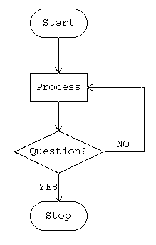
Two Themes:
Process & Results

Slide 7
Qu. Will We be able to Attain POs
Under the Curriculum?
Notes:
To answer the question:

Slide 8
Participants in Curriculum Review/ Design More True for Tier-1, But …
Faculty {Team}
Industry
Academics from Peer Institutions {Very Desirable}
Students and Alumni
Academic Bodies

Slide 9
The Curriculum Committee
Needs to Keep in view also
The PEOs & Resources

Slide 10
For Tier-1, the entire responsibility rests with the Institutions

Slide 11
Structure of Curriculum of a
Typical Engineering Program

Slide 12
Broad Outline
Mathematics, Physics, Basic Engineering Sciences,
Humanities, Communication
Core (Compulsory) Electrical Engineering Courses
{Electives}
Type 1 Type 2 Type 3 Type 4
Projects, Internships, Assignments, ..
Notes:
This is only a discussion item. Not NBA.

Slide 13
1 Contents of Basic Science, Humanities, and Program Specific Courses – Core, Elective
2 Content Delivery*
3 Laboratory Work
4 Project Work
Questions in slide 5 need to be answered along with evidence:
Processes of Development with documentation?
Notes:
For content delivery- class notes of students, course files, text books used. In P1 we have separated curriculum into two parts- common and program specific.

Slide 14
Content Delivery
Class notes of students
Course files*
Text books used.
Any Demos during the lectures?
Attending lecture(s)- {Visit Schedule}
Notes:
Demos can be very helpful at some places. Cla ss notes of students reveal quite a lot. It tells as to what happened in the course.

Slide 15
Course Files
Much (though not all) of the Evidence for Direct Evaluations will come from the course files.
Importance of Detailed and well maintained course files can not be overstated.
It is the prime responsibility of the faculty.
EE-201

Slide 16
Framework
PEO
Program Outcomes
3
Curriculum &
Teaching, Learning
Course Outcomes
2
1
Notes:
Begin with a level 0 solution

Slide 17

Curriculum Design Flow
For Evaluators – Records?
Define PEOs
Place Starting Design alongside NBA’s Program Outcomes.
Can you cover All POs within the Credit Limit Requirements?
If Yes, then Sequencing Requirements? Else,
In a Few iterations a Solution should emerge {Hopefully}

Slide 18
Sample Syllabus
Course: Electrical Circuits and Network Theory.
Offered in either 2nd or 3rd semester to students of Electrical Sciences. Credits: (Typical) 3-1-0. Course is Compulsory.
Course Objective: To prepare a student to take courses normally offered in subsequent semesters, like: Electronic Circuits, Signals and Systems, Advanced Electronics, etc.
Syllabus: The circuit concept as an approximation to a physical system {modeling, Application of laws of physics (PO 1)}. Kirchoff’s Laws, voltage and current sources, Network equations, use of source transformations, Loop and Nodal analysis, Matrix representation of circuit equations and their solutions {Apply knowledge of mathematics (PO1)} Continued…

Slide 19
Transient response, solution of differential equations with constant coefficients, initial and final conditions, time constant, its physical significance, and use in solving engineering problems {PO 2 particularly, switching circuits}. Use of Laplace transform in circuit analysis {again PO 1}
Two-port networks, two-port parameters {necessary for all the electronics systems that would follow}, sinusoidal steady state analysis and frequency response
Use of computers for solving large problems {PO 5}
Text books: 1.Van Valkenburg, Network Analysis, 3rd Edition, PHI. {For an 8 credit advanced course}
2. V Del Toro, Electrical Engineering Fundamentals, 2nd Edition
{For a 6 credit standard course}
Course Outcomes: PO 1, PO 2, PO 5
Reference: The Mathematics of Circuit Analysis, E.A. Guillemin, Oxford & IBH

Slide 20
Some Sample COs
Course | Module | Course Outcome
Digital Electronics | Karnaugh Map of Logic Functions | Students will be Able to simplify Boolean Expressions
“ | Interfacing different Logic Families | Students acquire ability to design digital systems by selecting different families in view of speed and power requirements.

Slide 21
It is a Good Practice to embed Course Outcomes (CO) in the Syllabus

Slide 22
One More Example of COs
Basic electrical circuits
UC Davis, Relationship to Outcomes:
Students who have successfully completed this course should have achieved:
Professional Component - Engineering Foundation
Course Outcomes | ABET outcomes A
A--An ability to apply knowledge of mathematics, science, and engineering
Notes:
The course belongs to Engineering Foundation of the curriculum.

Slide 23
Electronic Circuits And Systems
Students who have successfully completed this course
should have achieved:
Course Outcomes | ABET outcomes
An ability to apply knowledge of mathematics, science, and engineering | A
An ability to use the techniques, skills, and modern engineering tools necessary for engineering practice. | K

Slide 24
One more Example
Next Three Slides
University of Florida
Department of Electrical and Computer Engineering
From the
Course : Foundations of Digital Signal Processing
Semester – Fall 2018

Slide 25
Foundations of Digital Signal Processing, EEL 4750/5502
Course Description– {Good Idea}
This course covers topics related to the foundations of digital signal processing. After completing this course, students should understand the essential properties of discrete -time signals and systems; understand the sampling and reconstruction of signals; be able to perform transform analysis of digital signals and systems, and apply filter design techniques; as well as understand the fundamental principles…

Slide 26
Course Objectives {Course Outcomes}
At the conclusion of this course, you should be able to:
• Apply discrete-time systems to discrete-time signals
• Explain aliasing caused by under-sampling data
• Apply convolution and correlation to modify and locate signals
• Design a system with the Z-transform
• Create a Fast Fourier transform algorithm
• Analyze data with the short-time Fourier transform / spectrogram
• Design FIR & IIR filters for modifying time-domain signals
• Analyze data with a multi-channel filter bank
• Apply linear prediction for optimal filtering
…

Slide 27
Recommended Materials
• Digital Signal Processing, 4th edition o Authors: John G. Proakis and Dimitris K. Manolakis
o Publisher: Prentice Hall, 2006
• EEL 4750/EEL 5525 Course notes o Author: Joel B. Harley
Recommended Software
• MATLAB (maybe Python)

Slide 28
Typical Documents
Needed by Evaluators
Curriculum Development Process Documents- {Committee constitution, Participants, Agendas and Minutes of meetings, etc}*
Courses of Study Bulletin- {Syllabi, Text books, Reference material, Credit structure, etc.}
Notes:
*In ABET one can find some excellent tracks of such documentation. How the meeting dates are finalized. How the homework (on curriculum) is allotted to different committee members etc is also a part of the documentation.

Slide 29
Have we answered all the questions that we had raised at the beginning?

Slide 30
In Curriculum, SAR Seeks Answers to:
Process for developing the curriculum exists and has been followed?
The curriculum is well balanced?
Level of syllabi is at the degree level?
It allows the NBA Program Outcomes to be attained (critical)

Slide 31
Q1. Process for developing the curriculum exists and has been followed? Yes / No?

Slide 32


Here, an Excellent curriculum!
Yes, Surely, But How did it come into being?
Evaluator
Dean /HOD
Notes:
Curriculum takes into account your PEO, vision and Mission. So, can not be Universal.

Slide 33

Q.2 Curriculum Well Balanced?
What does it mean?
Notes:
It has all the components cited in slides 15 and 22.

Slide 34
Task Force on the Undergraduate Educational Commons
Massachusetts Institute of Technology, October 2006
“General Institute Requirements,” the rigorous foundation in natural science, mathematics, technology, humanities, arts, and social sciences that forms the core curriculum of an MIT undergraduate education.
The Task Force affirms the many ways in which this common curriculum has successfully prepared MIT’s graduates for a lifetime of learning and leadership
Notes:
Key words are in the bold. We come back to the second component again a little later. We can not be under ant illusion that we can teach all they will need in their lifetimes.

Slide 35
ABET’s Take on Balance
The curriculum must support attainment of the student outcomes and must include:
(a) one academic year of a combination of college-level mathematics and basic sciences (some with experimental experience).
(b) one and one-half academic years of engineering topics, of engineering sciences and engineering and utilizing modern engineering tools.

Slide 36
(c) a broad education component that includes humanities and social sciences, complements the technical content of the curriculum, and is consistent with the PEOs.
Students must be prepared to enter the professional practice of engineering through a curriculum culminating in a major design experience based on the knowledge and skills acquired in earlier course work

Slide 37
Qu.: Rank the curriculum content distributions of the four programs in the table below.
Course Cont. | Curriculum Content (%) of total number of credits
 | (a) | (b) | (c) | (d)
Basic Sciences | 5 | 20 | 15 | 15
Engineering Sciences | 5 | 10 | 15 | 12
H & Soc. Sc | 5 | 10 | 10 | 10
Program Core | 45 | 15 | 20 | 15
Program Electives | 20 | 10 | 10 | 10
Open Electives | 5 | 10 | 5 | 5
Projects | 10 | 20 | 20 | 28
Internships/seminars | 5 | 5 | 5 | 5

Slide 38
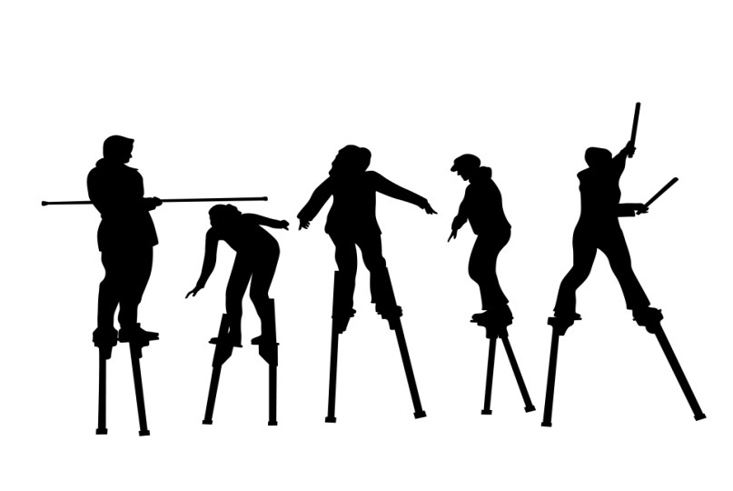
We have seen the broad structure of an Engineering Curriculum and examined it for balance.
So, it could be:
Well Balanced
Fairly Balanced
Could have been better Balanced
Review Committee

Slide 39
Q 3. Level of syllabi is at the degree level?
This is a judgment call that
Experts have to take

Slide 40
Q4. Does it ( the Curriculum)allow the NBA Program Outcomes to be attained (critical)
How? Was Answered in Part- 1

Slide 41
If All the Four Questions
can be Answered in the
Affirmative
The Job is Done!

Slide 42
End Part 2

Slide 43
Thank You!

Slide 44
Summary- as per SAR
2.1.1. State the process for designing the program curriculum (10)*
2.1.2. Structure of the Curriculum (5)
2.1.3. State the components of the curriculum (5)
2.1.4. State the process used to identify extent of compliance of the curriculum for attaining the Program Outcomes. (10)*

Slide 45
Curriculum
Course Outcomes
Program Outcomes
If True, Done
Teaching/Learning/Assessment/Evaluations

Slide 46
Typical Core Composition for EE
Mathematics* – 4/5 courses
Physics – 3/4 Courses
Chemistry 1/2
Biology (?) ≥ 1
Humanities and Social Sciences ¾

Slide 47
Maths: Calculus (1/2), Linear Algebra, Discrete Maths, Complex Variables
Physics: General Physics, Electricity & Magnetism (Adv), Modern Physics,

Slide 48
Important Takeaways
Even in Curriculum Design Evidence matters.
Define, Follow and Record the entire Design Process.
All the Questions raised are answered.

Slide 49

Curiosity &
"curiosity killed the cat" "but satisfaction brought it back".

Slide 50
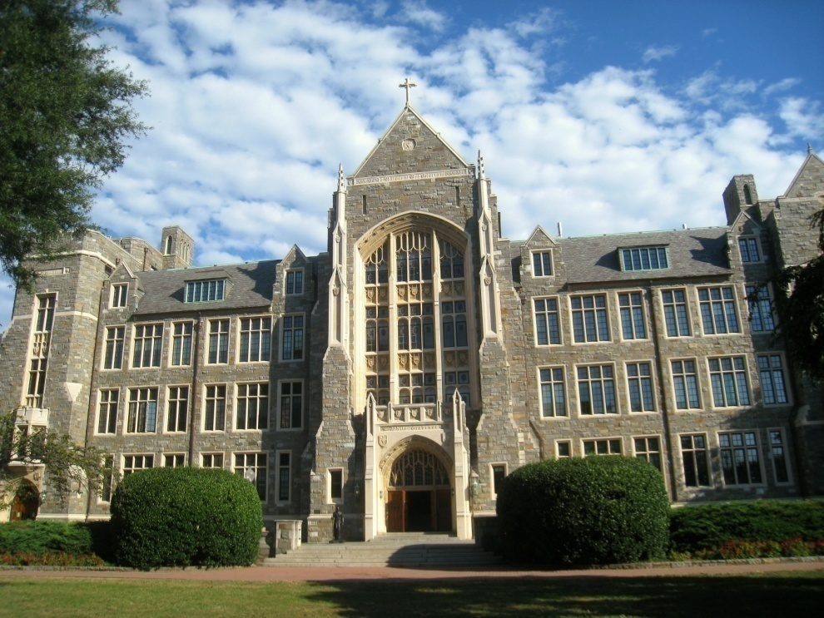
Tier - 2
Curriculum – Affiliating University
It may or may not allow all POs to be attained.
If Not, then….
.

Slide 51
Curriculum Design Process for Tier – 2:
Determine which POs are attainable by the University Curriculum..
Leads to gaps (if any) to be identified.
List All the Gaps.
Design additions to the curriculum to bridge gaps – and Document all these processes.
{May be, It’s a good idea to keep the University informed}

