Slide 1

“Awareness Workshop on Outcome Based Accreditation”

Slide 2
ABOUT NBA
Established in the year 1994 under Section 10 (u) of AICTE Act.
NBA became Autonomous in January 2010 and in April 2013 the Memorandum of Association and Rules of NBA were amended to make it completely independent of AICTE, administratively as well as financially.
NBA now independent in its functioning: decision making as well as financially.
Does not receive any grant either from the government or from any regulatory body of technical and higher education.

Slide 3
NBA
NBA is committed to provide:
Credible System of Accreditation
Transparent & Accountable System

Slide 4
Credible System of Accreditation
Strength and credibility of accreditation process largely lies in the integrity, honesty, expertise and professionalism.
Evaluators – face of NBA.
Transparency-
  Report discussed in the meetings of EAC in presence of all team chair
  Recommendations of EAC are considered in Sub-committee of AAC chaired by Chairman, NBA
  Copy of the report is sent to the Institution
  Change in decision communicated to the institution with reasons
  360 degree feedback

Slide 5
VISIT
During the two and a half day visit, the team has discussions with
the Head of the institute/Dean/Heads of Department /Program and course coordinators
a member of the management (to discuss how the program fits into the overall strategic direction and focus of the institution and management support for continued funding and development of the program)
faculty members
alumni
Students
Employers

Slide 6
Accreditation
Accreditation is a process of quality assurance and improvement, whereby a program in an approved Institution is critically appraised to verify that the program continues to meet and/or exceed the Norms and Standards prescribed by regulator from time to time.
It is a kind of recognition which indicates that a program fulfills desired standards.

Slide 7
WHAT IS NOT THE PURPOSE OF ACCREDITATION
Not to find faults with the institution but to assess the status-ante of the performance.
Not to denigrate the working style of the institution and its programs but to provide a feed back on their strengths and weaknesses.
Not to demarcate the boundaries of quality but to offer a sensitizing process for continuous improvement in quality provisions.
Not to select only institutions of national excellence but to provide benchmarks of excellence and identification of good practices.

Slide 8
General Policy on Accreditation
The following general policies are the guiding principles for the accreditation of programs:
Programs, and not Educational Institutions, are considered for accreditation.
Programs from which at least two batches of students have graduated are considered for accreditation.

Slide 9
What is Outcome based Education?
what the students need to learn?
What the students should demonstrate to the professional world?
Accordingly designing both curricula and delivery mechanisms(teaching strategies) to build the required skills and competence.

Slide 10
Outcome-based Program Accreditation
Knowledge and competencies profiles
Graduate attributes which form the student learning outcomes:
  Engineering knowledge
  Problem analysis
  Design/development of solutions
  Investigation
  Modern tool usage
  The engineer and society
  Environment and sustainability
  Ethics
  Individual and team work
  Communications
  Project management and finance
  Life-long learning

Slide 11
NBA Outcome Based Accreditation
Two Tier System
Introduction of Two-Tier System based on Types of Institutions.
The Tier–I documents: applicable to the engineering/technology programs offered by academically autonomous institutions and by university departments and constituent colleges of the universities.
Tier-II documents: for non-autonomous institutions, i.e., those colleges and technical institutions which are affiliated to a university.
For both: Same set of criteria have been prescribed for accreditation.

Slide 12
Marks Comparison of SAR of UG Engineering
Tier-I & Tier II
S.No. | Criteria | UG Engineering
 |  | Tier-I | Tier-II
1. | Vision, Mission and Program Educational Objectives | 50 | 60
2. | Program Curriculum and Teaching – Learning Processes | 100 | 120
3. | Course Outcomes and Program Outcomes | 175 | 120
4. | Students’ Performance | 100 | 150
5. | Faculty Information and Contributions | 200 | 200
6. | Facilities and Technical Support | 80 | 80
7. | Continuous Improvement | 75 | 50
8. | First Year Academics | 50 | 50
9. | Student Support Systems | 50 | 50
10. | Governance, Institutional Support and Financial Resources | 120 | 120
TOTAL |  | 1000 | 1000

Slide 13
Tier – I Grades
≈75% & Above | ‘Y’
≈ 60% and <75% | ‘C’
≈ 40% and <60% | ‘W’
<40% | ‘D’

Slide 14
POSTGRADUATE ENGINEERING SAR
Criteria No. | Criteria | Mark/Weightage
 | Department Level Criteria
1. | Program Curriculum and Teaching – Learning Processes | 125
2. | Program Outcomes | 75
3. | Students’ Performance | 75
4. | Faculty Contributions | 75
5. | Laboratories and Research Facilities | 75
6. | Continuous Improvement | 75
 | Total | 500

Slide 15
Award of Accreditation-Tier-I (UG)
Full Accreditation for Six years will be accorded to a program on
fulfilment of the following requirements :
If there is no “Deficiency” or “Weakness” in any of the criteria laid down by NBA with at least “07 Criteria” shall be fully compliant and “Concerns” in the remaining criteria.
Number of available Ph.D. in the department is greater than or equal to 30% of the required number of faculty averaged for previous two academic years including Current Academic Year.
The admissions in the UG program at the program level are more than or equal to 75% while at the institute level, the admissions are required to be more than or equal to 60%, averaged over previous three academic years including Current Academic Year.
Faculty Student Ratio in the department is less than or equal to 1:15 averaged for the previous three academic years including current academic year.
At least 2 Professors or 1 Professor and 1 Associate Professor (on a full-time/regular basis) with Ph.D. degree are available in the respective department for previous two academic years including current academic year.
The placement ratio (Placement + higher studies) is greater than or equal to 40% averaged for the previous three academic years
HOD of the program under consideration possesses Ph.D. degree
#Y shall be >=7, #W and #D shall be Zero (0), where the symbol # has been used to indicate the count.

Slide 16
Full Accreditation for six years may be considered for a program after three months:
“#Y” shall be greater than or equal to 07
“#C” shall be less than or equal to 02
“#W” shall be less than or equal to 02
“#D” shall be zero.
The institution is required to submit a compliance report to NBA describing action taken in response to the identified “Weakness (es)” and “Concerns”.

Slide 17
Provisional Accreditation for Three years will be accorded to a program on fulfilment of the following requirements:
“#Y” shall be greater than or equal to 04
“#D” shall be less than or equal to 02
At least two Professors or one Professor and one Associate Professor (on a full-time/regular basis) with Ph.D. Degree are available in the respective Department for previous two academic years including Current Academic Year.
The faculty student ratio in the department under consideration is less than or equal to 1:25 averaged for the previous three academic years including Current Academic Year.
Number of available Ph.D. in the department is greater than or equal to 20% of the required number of faculty averaged for previous two academic years including Current Academic Year
The placement ratio (Placement + higher studies) is greater than or equal to 40% averaged over previous three academic years
The HOD of the program under consideration possesses Ph.D. degree.
In case of a “D” in Criterion – V (Faculty Information & Contributions), the program will not be considered for accreditation

Slide 18
No Accreditation of the program:
If the program fails to meet criteria for award of provisional accreditation for 3 years, the program will not be considered for accreditation.

Slide 19
Award of Accreditation-Tier-II (UG)
Full Accreditation for Six years will be accorded to a program on
fulfilment of the following requirements:
Program scoring a minimum of 750 points in aggregate out of 1000 points with minimum score of 60% in mandatory fields (criteria 4 to 6)
The number of available Ph.D. in the department is greater than or equal to 30% of the required number of faculty averaged for previous two academic years including current academic year
Admissions in the UG program at the program level are more than or equal to 75% while at the institute level, the admissions are more than or equal to 50%, averaged for previous three academic years including Current Academic Year
Faculty Student Ratio in the department is less than or equal to 1:15 averaged for the previous three academic years including current academic year.
At least 2 Professors or 1 Professor and 1 Associate Professor (on a full -time/regular basis) with Ph.D. Degree are available in the concerned department for previous two academic years including current academic year.
The placement ratio (Placement + higher studies) is greater than or equal to 40% averaged for the previous three academic years
The HOD of the program under consideration possesses Ph.D. Degree.

Slide 20
Provisional Accreditation for Three years will be accorded to a program on fulfilment of the following requirements:
The score for the program is greater than or equal to 600 points with minimum 40% marks in Criterion V (Faculty Information and Contributions).
At least one Professor or one Associate Professor with Ph.D. degree (on a full -time/regular basis) is available in the respective Department for previous two academic years including current academic year
The student faculty ratio in the department under consideration is less than or equal to 1:25 averaged for previous three academic years including current academic year
The number of available Ph.D. in the department is greater than or equal to 10% of the required number of faculty averaged for previous two academic years including current academic year
The placement ratio (Placement + higher studies) is greater than or equal to 40% averaged over previous three assessment years.

Slide 21
No Accreditation of the program:
If the program scores less than 600 marks or less than 40% marks in Faculty Information and Contributions (Criterion V) or fails to meet the criteria for award of provisional accreditation for 3 years, the program will not be considered for accreditation

Slide 22
Award of Accreditation- (PG Engineering New SAR)
Full Accreditation for Six years will be accorded to a program on
fulfilment of the following requirements:
Qualifying marks shall be greater than 375 with 60% in each criteria
Number of available Ph.D. in the department shall be greater than or equal to 30% of the required number of faculty averaged for previous two academic years including current academic year.
FSR in the department under consideration shall be better than or equal to 1:15 averaged for previous three academic years including current academic year.
At least one Professor and one Associate Professor with Ph.D. degree (on a full-time/ regular basis) having expertise in the domain of the program under consideration for previous two academic years including current academic year.

Slide 23
Provisional Accreditation for Three years will be accorded to a program on fulfilment of the following requirements:
Qualifying marks shall be greater than or equal to 300 with 50% in Criteria – V (Faculty Contribution)
In case of Tier I, whether the corresponding UG Engineering program has been granted at least 5 Compliances (or) In case of Tier II, whether the corresponding UG Engineering program has been granted at least 700 marks out of 1000.
The admission of GATE qualified students in the program has been more than or equal to 40% excluding sponsored category of students.* (Averaged over previous three academic years including the current academic year)
At least one professor with Ph.D. qualification having expertise in the domain of the Program under consideration during previous two Academic Years including the Current Academic Year).
The department have at least two faculty having Ph.D. qualification during the previous two academic year including the current academic year.
Faculty student ratio in the department under consideration is better than or equal to 1:25 averaged over the previous three academic years including the current academic year

Slide 24
No Accreditation of the program:
Below 300 marks

Slide 25
Award of Accreditation
Engineering Programs
 | Full Accreditation for Six years
Sl. No. | Parameters | Undergraduate (UG) Programs |  | PG Programs
 |  | TIER I | TIER II
 | Maximum Marks/ Grade required | # ‘Y’ shall be >=7 # ‘W’ and # ‘D’ shall be Zero (0), Where the symbol # has been used to indicate the count. | Scoring a minimum of 750 points in aggregate out of 1000 points with minimum score of 60% in mandatory fields (criteria 4 to 6) | Qualifying marks shall be greater than 375 with 60% in each criteria
 | Minimum percentage (%) of Ph. D. required in the department averaged for previous two academic years including Current Academic Year | 30% | 30% | 30%
 | Minimum percentage (%) of admissions required in the UG program at the program level (averaged over previous three academic years including Current Academic Year) | 75% | 75% | -
 | Minimum percentage (%) of admissions required in the UG program at the institute level (averaged over previous three academic years including Current Academic Year) | 60% | 50% | -
 | The required Faculty Student Ratio (FSR) in the department (averaged for the previous three academic years including current academic year) | 1:15 | 1:15 | 1:15
 | The required number of Professors & Associate Professors (on a full-time/regular basis with Ph.D.) in the respective department for previous two academic years including current academic year | At least 2 Professors or 1 Professor and 1 Associate Professor | At least 2 Professors or 1 Professor and 1 Associate Professor | At least 1 Professor and 1 Associate Professor (having expertise in the domain of the program under consideration)
 | Minimum percentage (%) placement ratio (Placement + higher studies) required (averaged for the previous three academic years) | 40% | 40% | -
 | HOD of the program under consideration shall possesses Ph.D. degree | √ | √ | √

Slide 26
 | Provisional Accreditation for Three years
Sl. No. |  | Undergraduate (UG) Programs |  | Postgraduate (PG) Programs
 |  | TIER I | TIER II
 | Maximum Grades/ Marks require | “#Y” shall be ≥ 04 “#D” shall be ≤ 02 Where the symbol # has been used to indicate the count. | The score for the program is greater than or equal to 600 points with minimum 40% marks in Criterion V (Faculty Information and Contributions). | Qualifying marks shall be greater than or equal to 300 with 50% in Criteria – V (Faculty Contribution)
 | Minimum percentage (%) of Ph. D. required in the department averaged for previous two academic years including Current Academic Year | 20% | 10% | at least two faculty with Ph.D. in the department
 | The required Faculty Student Ratio (FSR) in the department (averaged for the previous three academic years including current academic year) | 1:25 | 1:25 | 1:25
 | The required number of Professors & Associate Professors (on a full-time/regular basis with Ph.D.) in the respective department for previous two academic years including current academic year | At least 2 Professors or 1 Professor and 1 Associate Professor | At least 1 Professor or 1 Associate Professor | At least 1 Professor in the respective domain
 | Minimum percentage (%) placement ratio (Placement + higher studies) required (averaged for the previous three academic years) | 40 % | 40 % | -
 | HOD of the program under consideration shall possesses Ph.D. degree | √ | √ | √

Slide 27
Pre-Qualifiers (TIER-II)
S.N. | Pre Visit Qualifiers | Current Status | Compliance Status Complied/Not Complied
 | Essential qualifiers
1 | Vision, Mission & PEOs Are the Vision & Mission of the Department stated in the Prospectus / Website? Are the PEOs of the Program listed in the Prospectus / Website?
2 | Whether approval of AICTE for the programs under consideration has been obtained for all the years including current year
3 | Whether admissions in the undergraduate programs at the Institute level has been more than or equal to 50% * (average of the previous three academic years including current academic year)
4 | Whether admissions in the undergraduate programs under consideration has been more than or equal to 50% ** (average of the previous three academic years including current academic year)

Slide 28
5 | Whether faculty student ratio in the department under consideration is better than or equal to 1:25 averaged over previous three academic years including current academic year. | % Admission
6 | Whether at least one Professor or one Associate Professor on regular basis with Ph.D. degree is available in the respective Department during previous two academic years including current academic year. | SFR
7 | Whether number of available Ph.Ds. in the department is greater than or equal to 10% of the required number of faculty averaged for previous two academic years including current academic year.
8 | Whether the Placement + Higher Studies+ Entrepreneurship ratio is greater than or equal to 40% (average of the last three academic years)
9 | Whether two batches have passed out in the programs under consideration

Slide 29
*Total number of students admitted in first year minus number of students migrated to other institutions, plus the number of students migrated to this institution divided by the sanctioned intake.
**Total number of students admitted in first year in the respective program minus number of students migrated to other programs/ institutions plus the number of students migrated to this program divided by the sanctioned intake in the respective program.

Slide 30
Pre-Qualifiers (TIER-I)
S.N. | Pre Visit Qualifiers (Average of Assessment years) | Current Status | Compliance Status Complied/Not Complied
 | Essential qualifiers
1 | Vision, Mission & PEOs Are the Vision & Mission of the Department stated in the Prospectus / Website? Are the PEOs of the Program listed in the Prospectus / Website?
2 | Whether approval of the competent authority (Approval of AICTE/ UGC/ BoG of Universities/ Deemed Universities etc.) for the programs under consideration has been obtained for all the years including current year
3 | Whether admissions in the undergraduate programs at the Institute level has been more than or equal to 60% * (average of the previous three academic years including Current Academic Year)
4 | Whether admissions in the undergraduate programs under consideration has been more than or equal to 60%** (average of the previous three academic | % Admission
5 | Whether faculty student ratio in the department under consideration is better than or equal to 1:25 averaged over previous three academic years including Current Academic Year. | SFR

Slide 31
6 | Whether at least two Professors or one Professor and one Associate Professor on regular basis with Ph.D. degree is available in the respective Department for previous two academic years including the Current Academic Year.
7 | Whether number of available PhDs in the department is greater than or equal to 20% of the required number of faculty averaged for previous two academic years including Current Academic Year.
8 | Whether the Placement, Higher Studies and Entrepreneurship ratio is greater than or equal to 40%. (average of the last three assessment years)
9 | Whether two batches have passed out in the programs under consideration
10 | Whether HODs possess Ph.D. degrees for the programs under consideration

Slide 32
*Total number of students admitted in first year minus number of students migrated to other institutions, plus the number of students migrated to this institution divided by the sanctioned intake.
**Total number of students admitted in first year in the respective program minus number of students migrated to other programs/ institutions plus the number of students migrated to this program divided by the sanctioned intake in the respective program.

Slide 33
Pre-Qualifiers (PG)
Sr. No. | Pre Visit Qualifiers | Current Status | Compliance Status Complied/Not Complied
1 | Whether corresponding UG Program is accredited by NBA.
2 | In case of Tier I, whether the corresponding UG Engineering program has been granted at least 4 Compliances (Y) or In case of Tier II, whether the corresponding UG Engineering program has been granted at least 650 marks out of 1000.
3 | Whether the admission of GATE qualified students in the program has been more than or equal to 40% excluding sponsored category of students.* (Averaged over previous three academic years including the current academic year).
4 | Whether at least one professor with Ph.D. qualification or one associate professor with Ph.D. qualification having expertise in the domain of the Program under consideration during previous two Academic Years including the Current Academic Year).

Slide 34
5 | Whether the department have at least two faculty having Ph.D. qualification during the previous two academic year including the current academic year.
6 | Whether faculty student ratio in the department under consideration is better than or equal to 1:25 averaged over the previous three academic years including the current academic year.
Note: Point No. 1 & 2 above will not be applicable to the Post Graduate Program, that do not have corresponding Under Graduate Program.
* If specialization not covered under GATE then those cases will be considered on case to case basis.

Slide 35
Guidelines for Faculty:
The PhD faculty count requirement shall be calculated on the pro-rota basis – with at least 75% to be part of the regular faculty, and the remaining being part of the contractual* faculty, if any. *(Only those who have taught for consecutive 2 semesters on full time basis)
The contractual faculty (doing away with the terminology of visiting/adjunct faculty, whatsoever) who have taught for 2 consecutive semesters in the corresponding academic year on full time basis shall be considered for the purpose of calculation in the Student Faculty Ratio.
If a member of regular or contractual faculty is designated as lecturer, even though holding an M.Tech degree, NBA shall not count him/her against the faculty requirements.
In the areas (like MBA or PGDM) or specialized areas like Biotechnology, all the qualifications relevant and purposeful to those disciplines need to be considered, in addition to the M.Tech/MBA/PGDM degrees.

Slide 36
There is no age limit to the consideration for the emeritus faculty as long as they are physically fit to take classes and engage with students, and are employed on a full time basis.
Regular faculty to be counted if completed 9 months for the current academic year.
NOTE: Kindly note that the year mentioned here is exemplary, institute has to consider the academic years as per the definition of CAY given in the document and according to the prevailing year.
CAY: Current Academic Year
CAYm1: Current Academic Year minus 1 = Current Assessment Year
CAYm2: Current Academic Year minus 2 = Current Assessment Year minus1
Academic year is considered from July to June.

Slide 37
Fees:-
Registration Fee:
Registration fee amount is Rs. 1,00,000/- + 18% GST(Goods and Services Tax)
Accreditation Fee:
Processing Fees to be paid by the Institutions for NBA Accreditation of Programmes except Engineering Diploma Programmes
No. of Programmes to be Accredited | Payment to be made with application + 18% GST(Goods and Services Tax)
1 | 5,00,000/-
2 | 7,00,000/-
3 | 9,00,000/-
4 | 11,00,000/-
5 | 13,00,000/-

Slide 38
No. of Diploma Programmes to be Accredited | Payment to be made with application + 18% GST(Goods and Services Tax)
1 | 2,00,000/-
2 | 3,50,000/-
3 | 5,00,000/-
4 | 6,50,000/-
5 | 8,00,000/-
Note: The Institutes can apply maximum for 5 programmes for various levels of the same discipline. However, MBA and MCA Programmes may be included along with Engineering Programmes in an application.
Appeal Fee:
Appeal fee amount is Rs. 1,50,000/- per Program. + 18% GST(Goods and Services Tax)

Slide 39
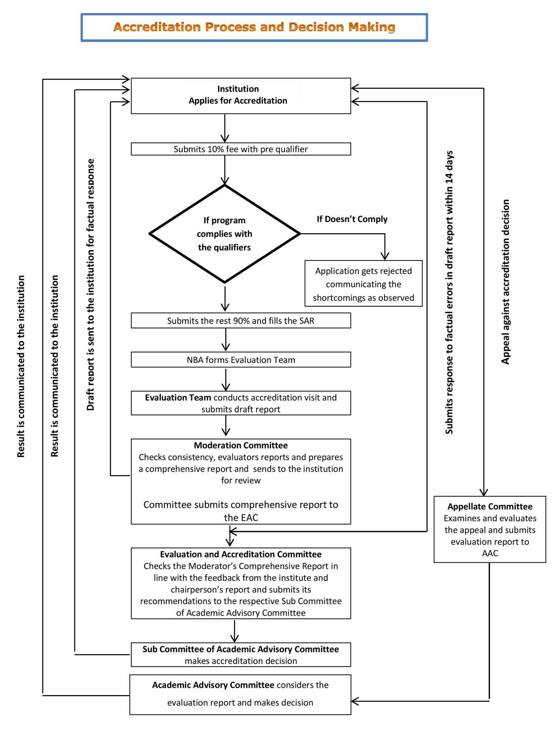

Slide 40
Process flow for the Compliance Report
Institutions are required to submit compliance report in respect of the programs which have been provisionally accredited for 3 years. These compliance report are to be submitted after the completion of two and half years of Provisional Accreditation. The processing fees for the compliance report is Rs. 2.00 Lac (for the first program) plus (+) Rs. 50, 000/- per additional program plus (+) applicable GST. The visit for the data verification pertaining to compliance report would be done by two member expert team.

Slide 41

World Summit on Accreditation
WOSA-2018
NBA announces WOSA-2018, the fourth in WOSA series of biennial conferences, during 7th to 9th September, 2018 in New Delhi, India.
Main Theme: Challenges and Opportunities in Outcome Based Accreditation
Other Themes
Theme 1 - Achieving Excellence through Learning Outcomes.
Theme 2 - Role of Industry in Technical Education.
Theme 3 - Ranking and Rating of Higher Education Institutions – Do they have a Role in Quality Improvement?
Theme 4 - Linking Government Funding with Quality.
Theme 5 - Use of ICT in Accreditation in Large Jurisdictions

Slide 42
Important Dates for the Conference
Timeline for Prospective Authors
Deadline for submitting full paper: 6th August 2018
Notification to authors: 15th August 2018
Conference presentation: 01st September 2018
Timeline for Registration
Last date for Early Bird Registration 6th August 2018
Last date for Online Registration 06th September 2018
Spot Registration 07th September 2018

Slide 43
Registration Fee
Registration Fee per Participant: Rs.20,000/- + 18% GST
Early Bird Registration: Discount of 20%, i.e.,
Rs.16,000/- + 18% GST
Group Registration: Groups of 5 from the same organization will receive registration free for the 6th participant.

Slide 44

Thank you

